Slide 1



62nd Anniversary

Slide 2
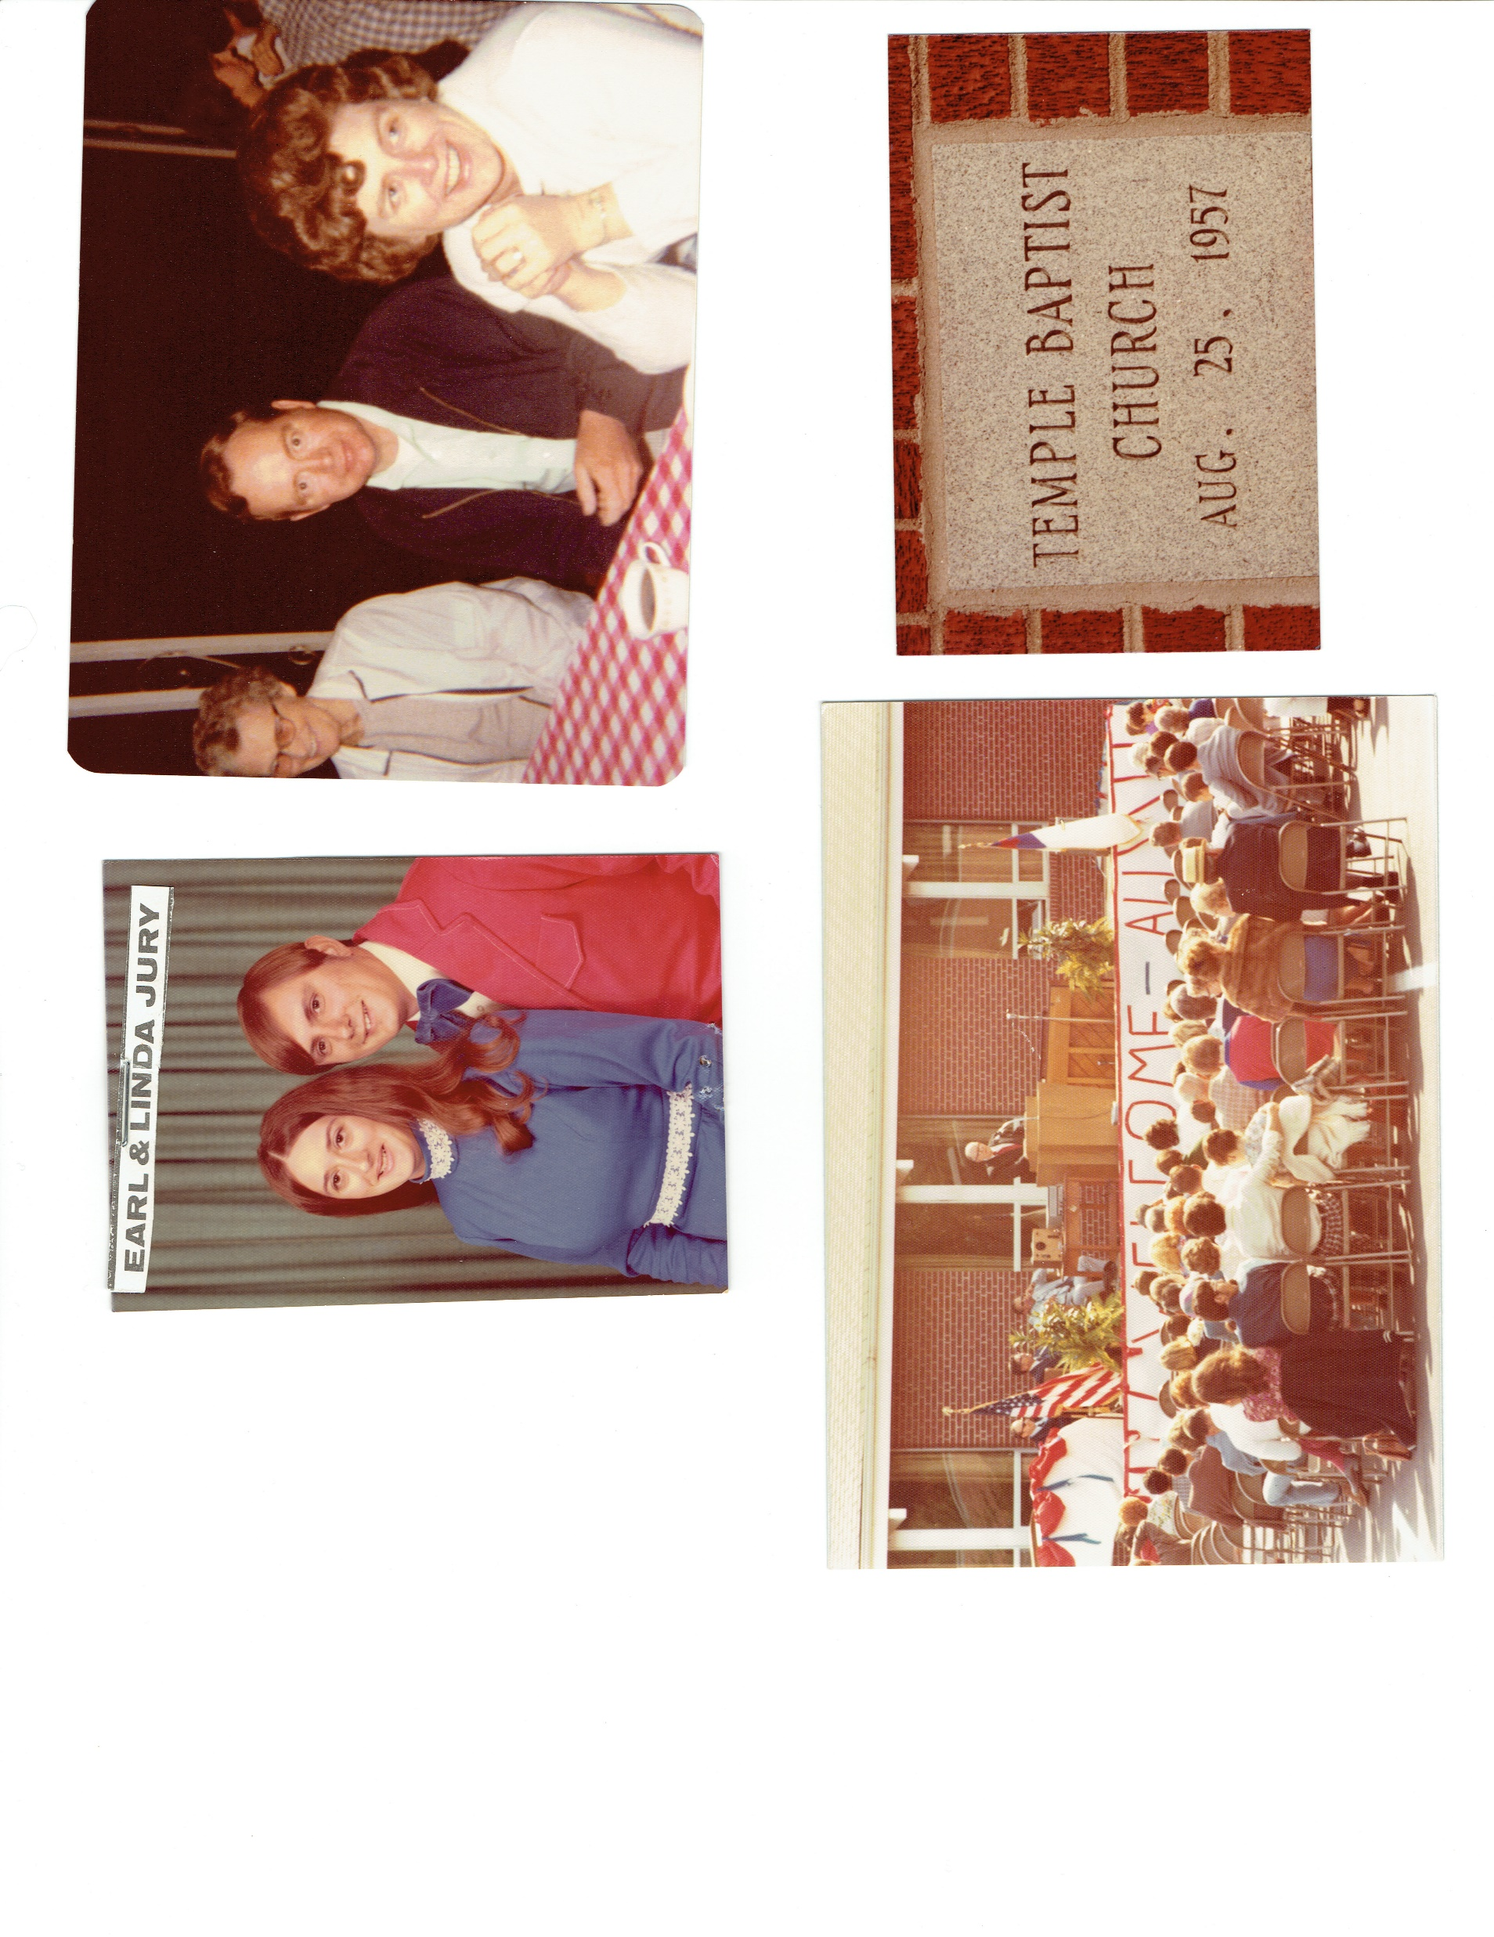

Slide 3
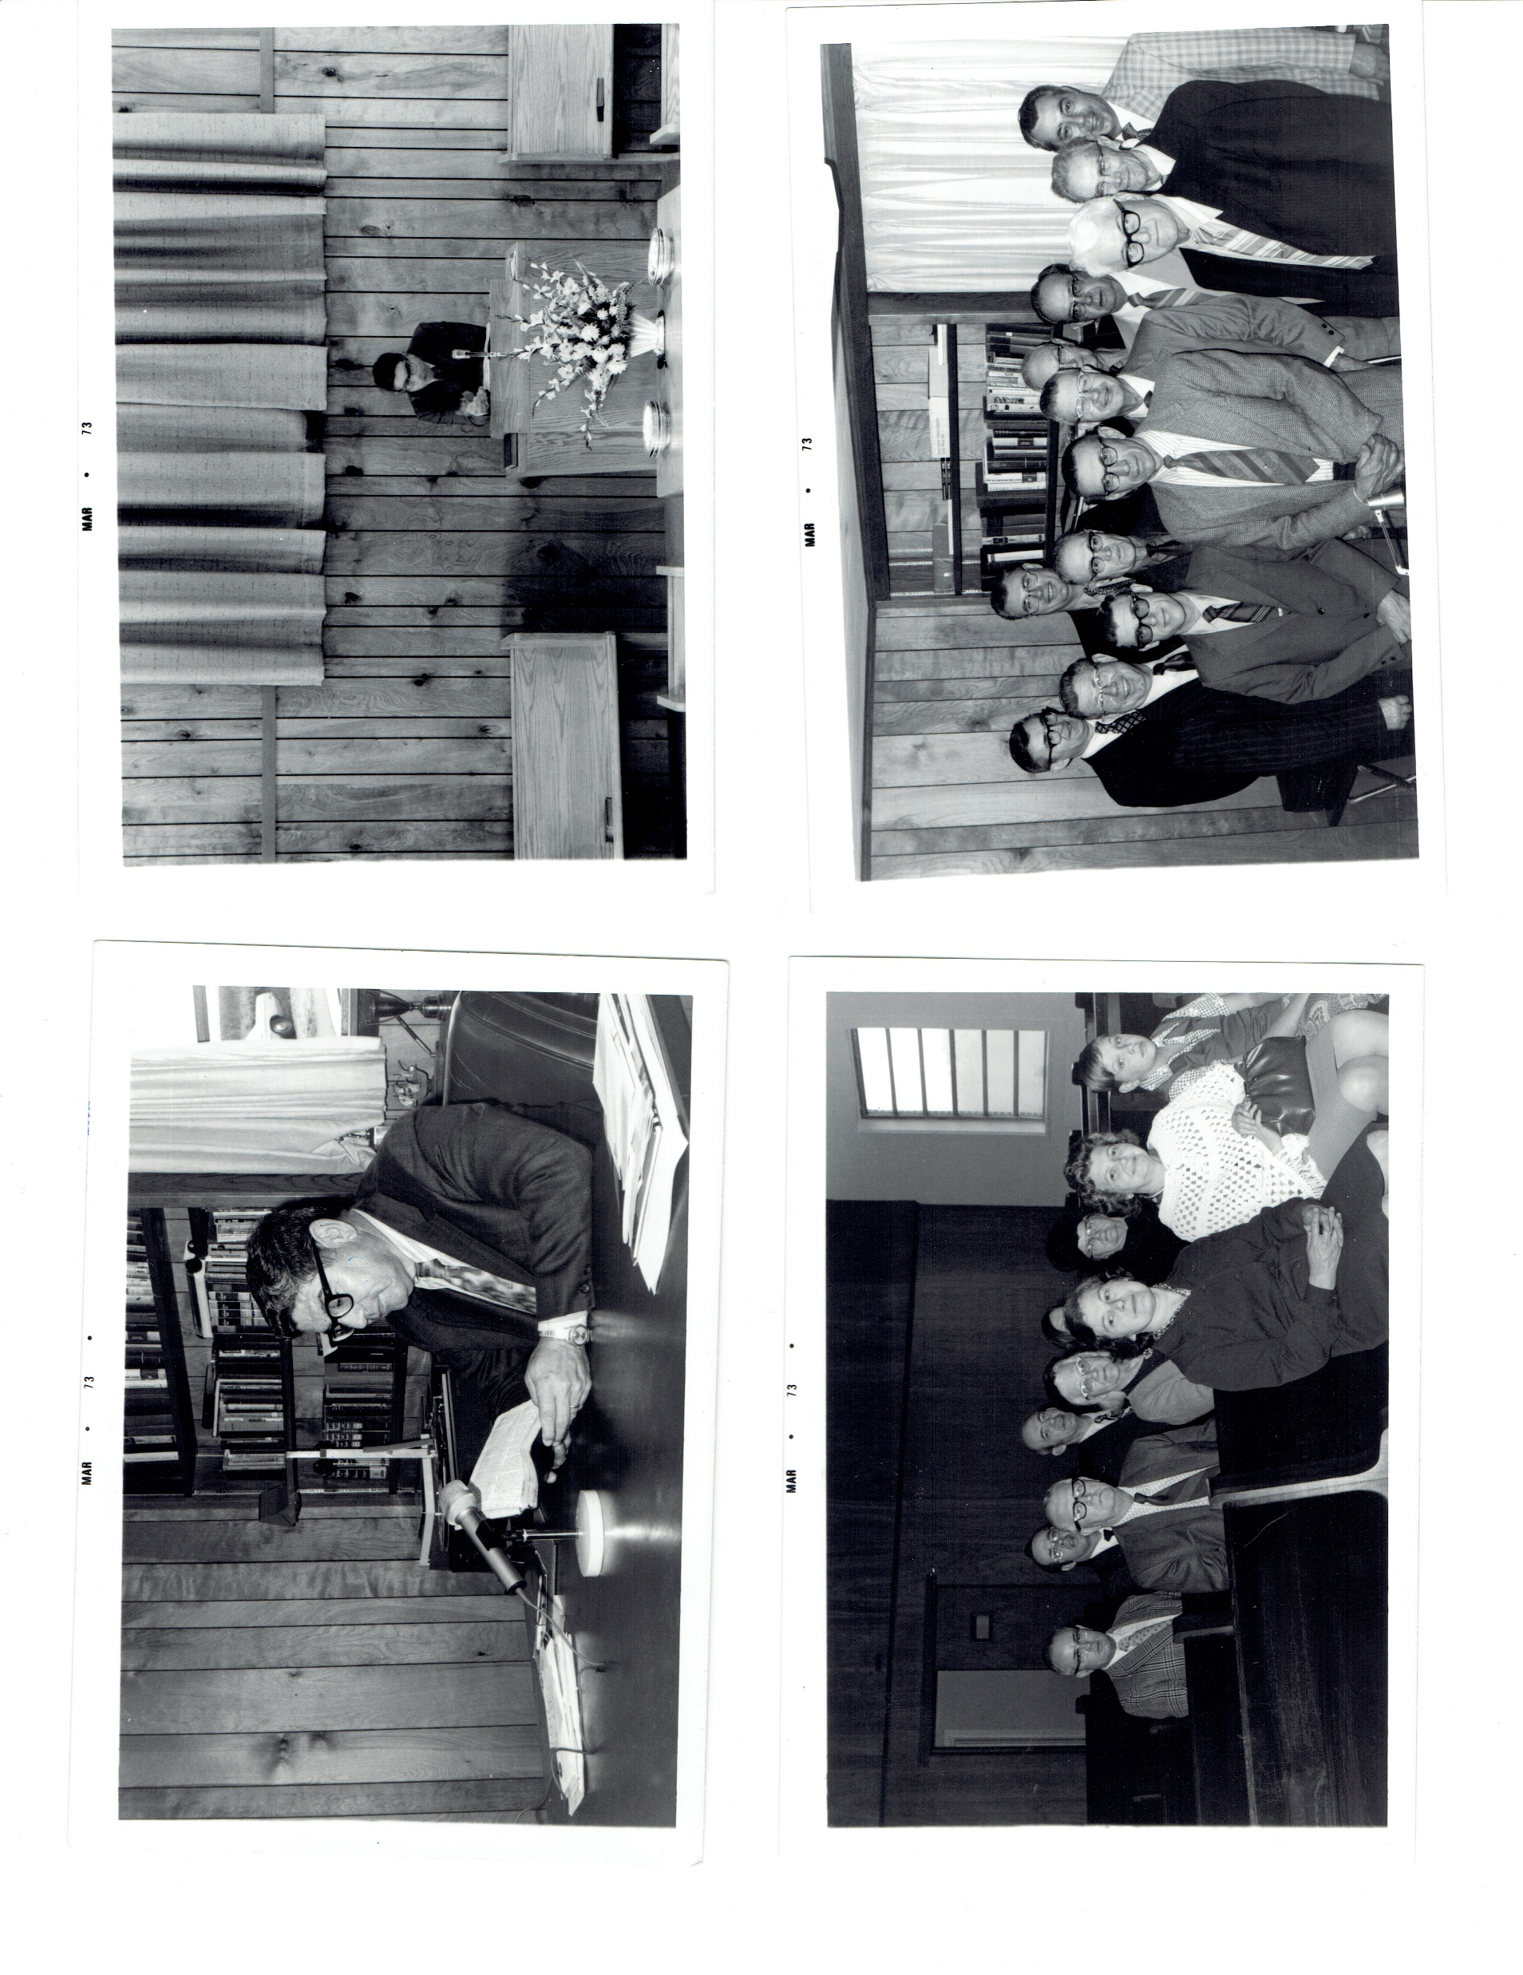
Pastor Joe Olachea’s Radio Broadcast

Slide 4
Deacons

Slide 5
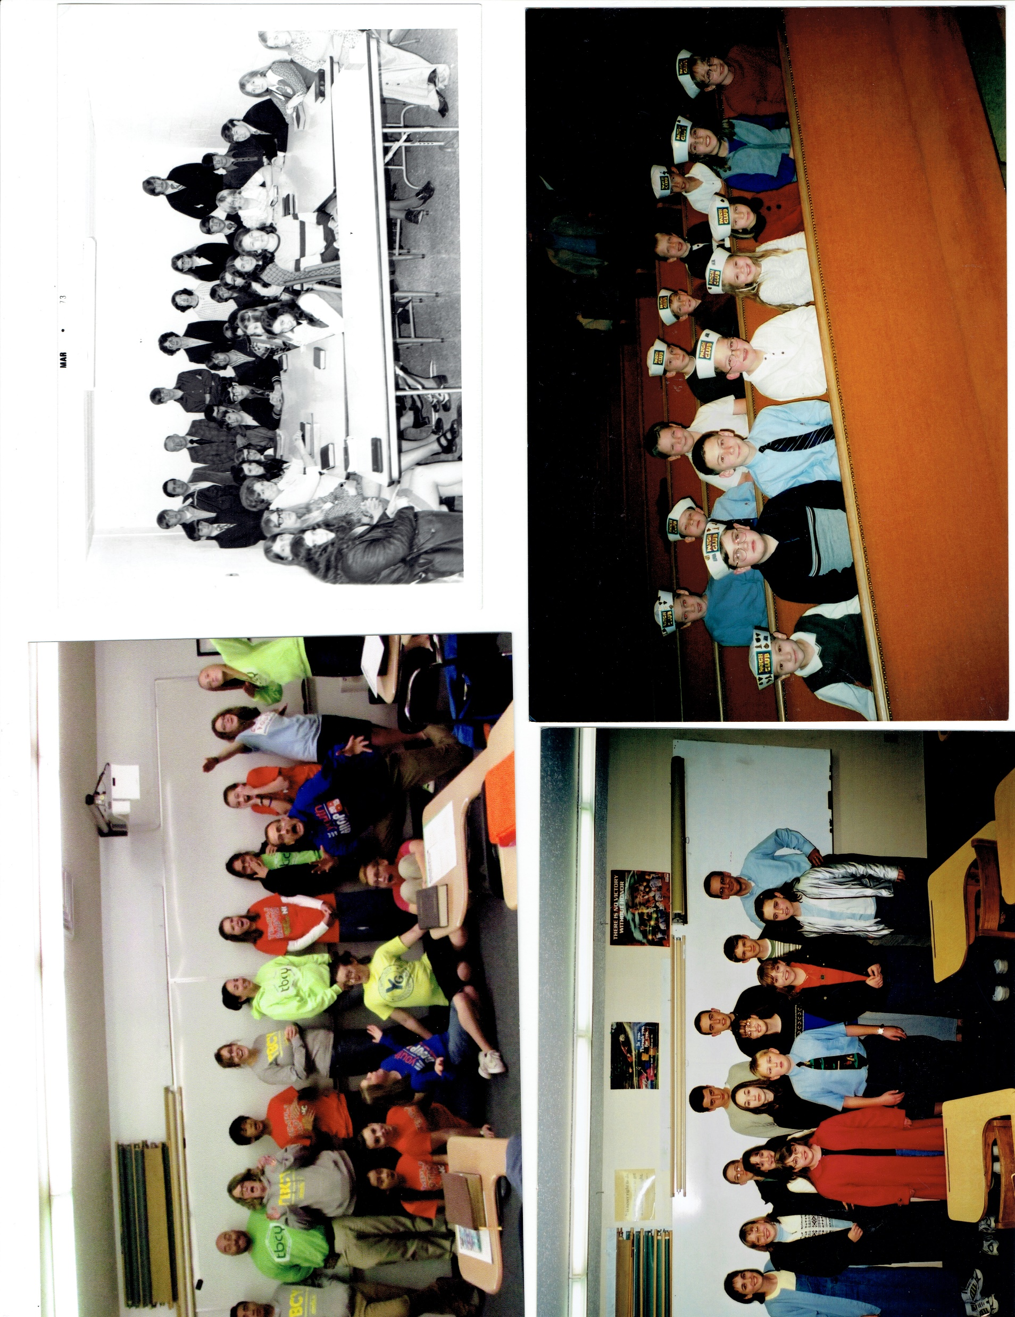
Youth Group

Slide 6
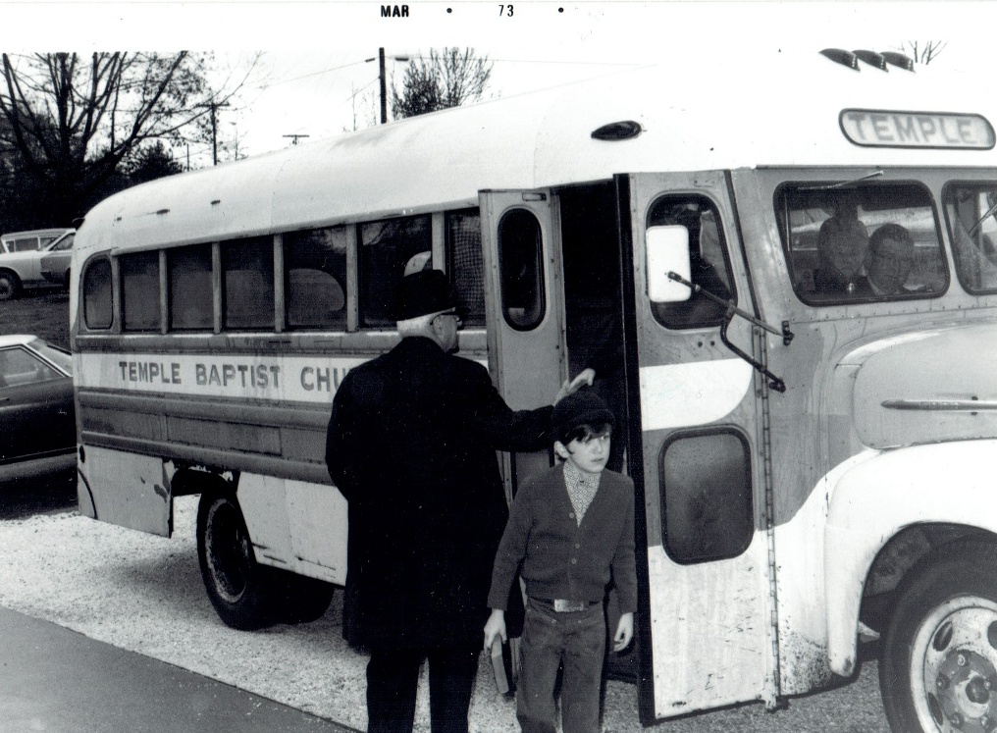
Bus Ministry

Slide 7

Bus Ministry

Slide 8
Church Service
in the Old Auditorium

Slide 9
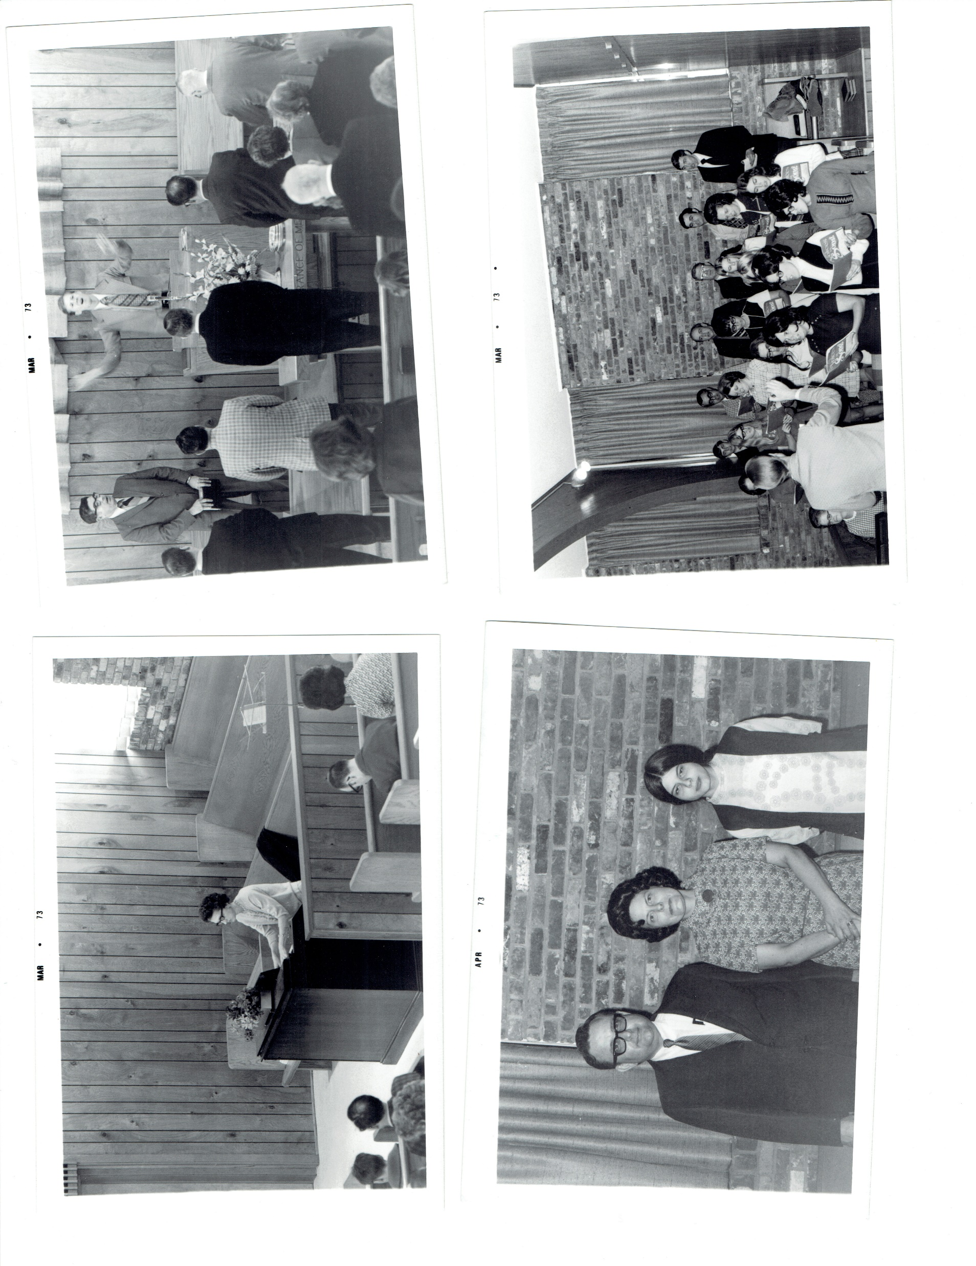
Church Service
in the Old Auditorium

Slide 10
Church Service
in the New Auditorium

Slide 11
Church Service
in the New Auditorium

Slide 12
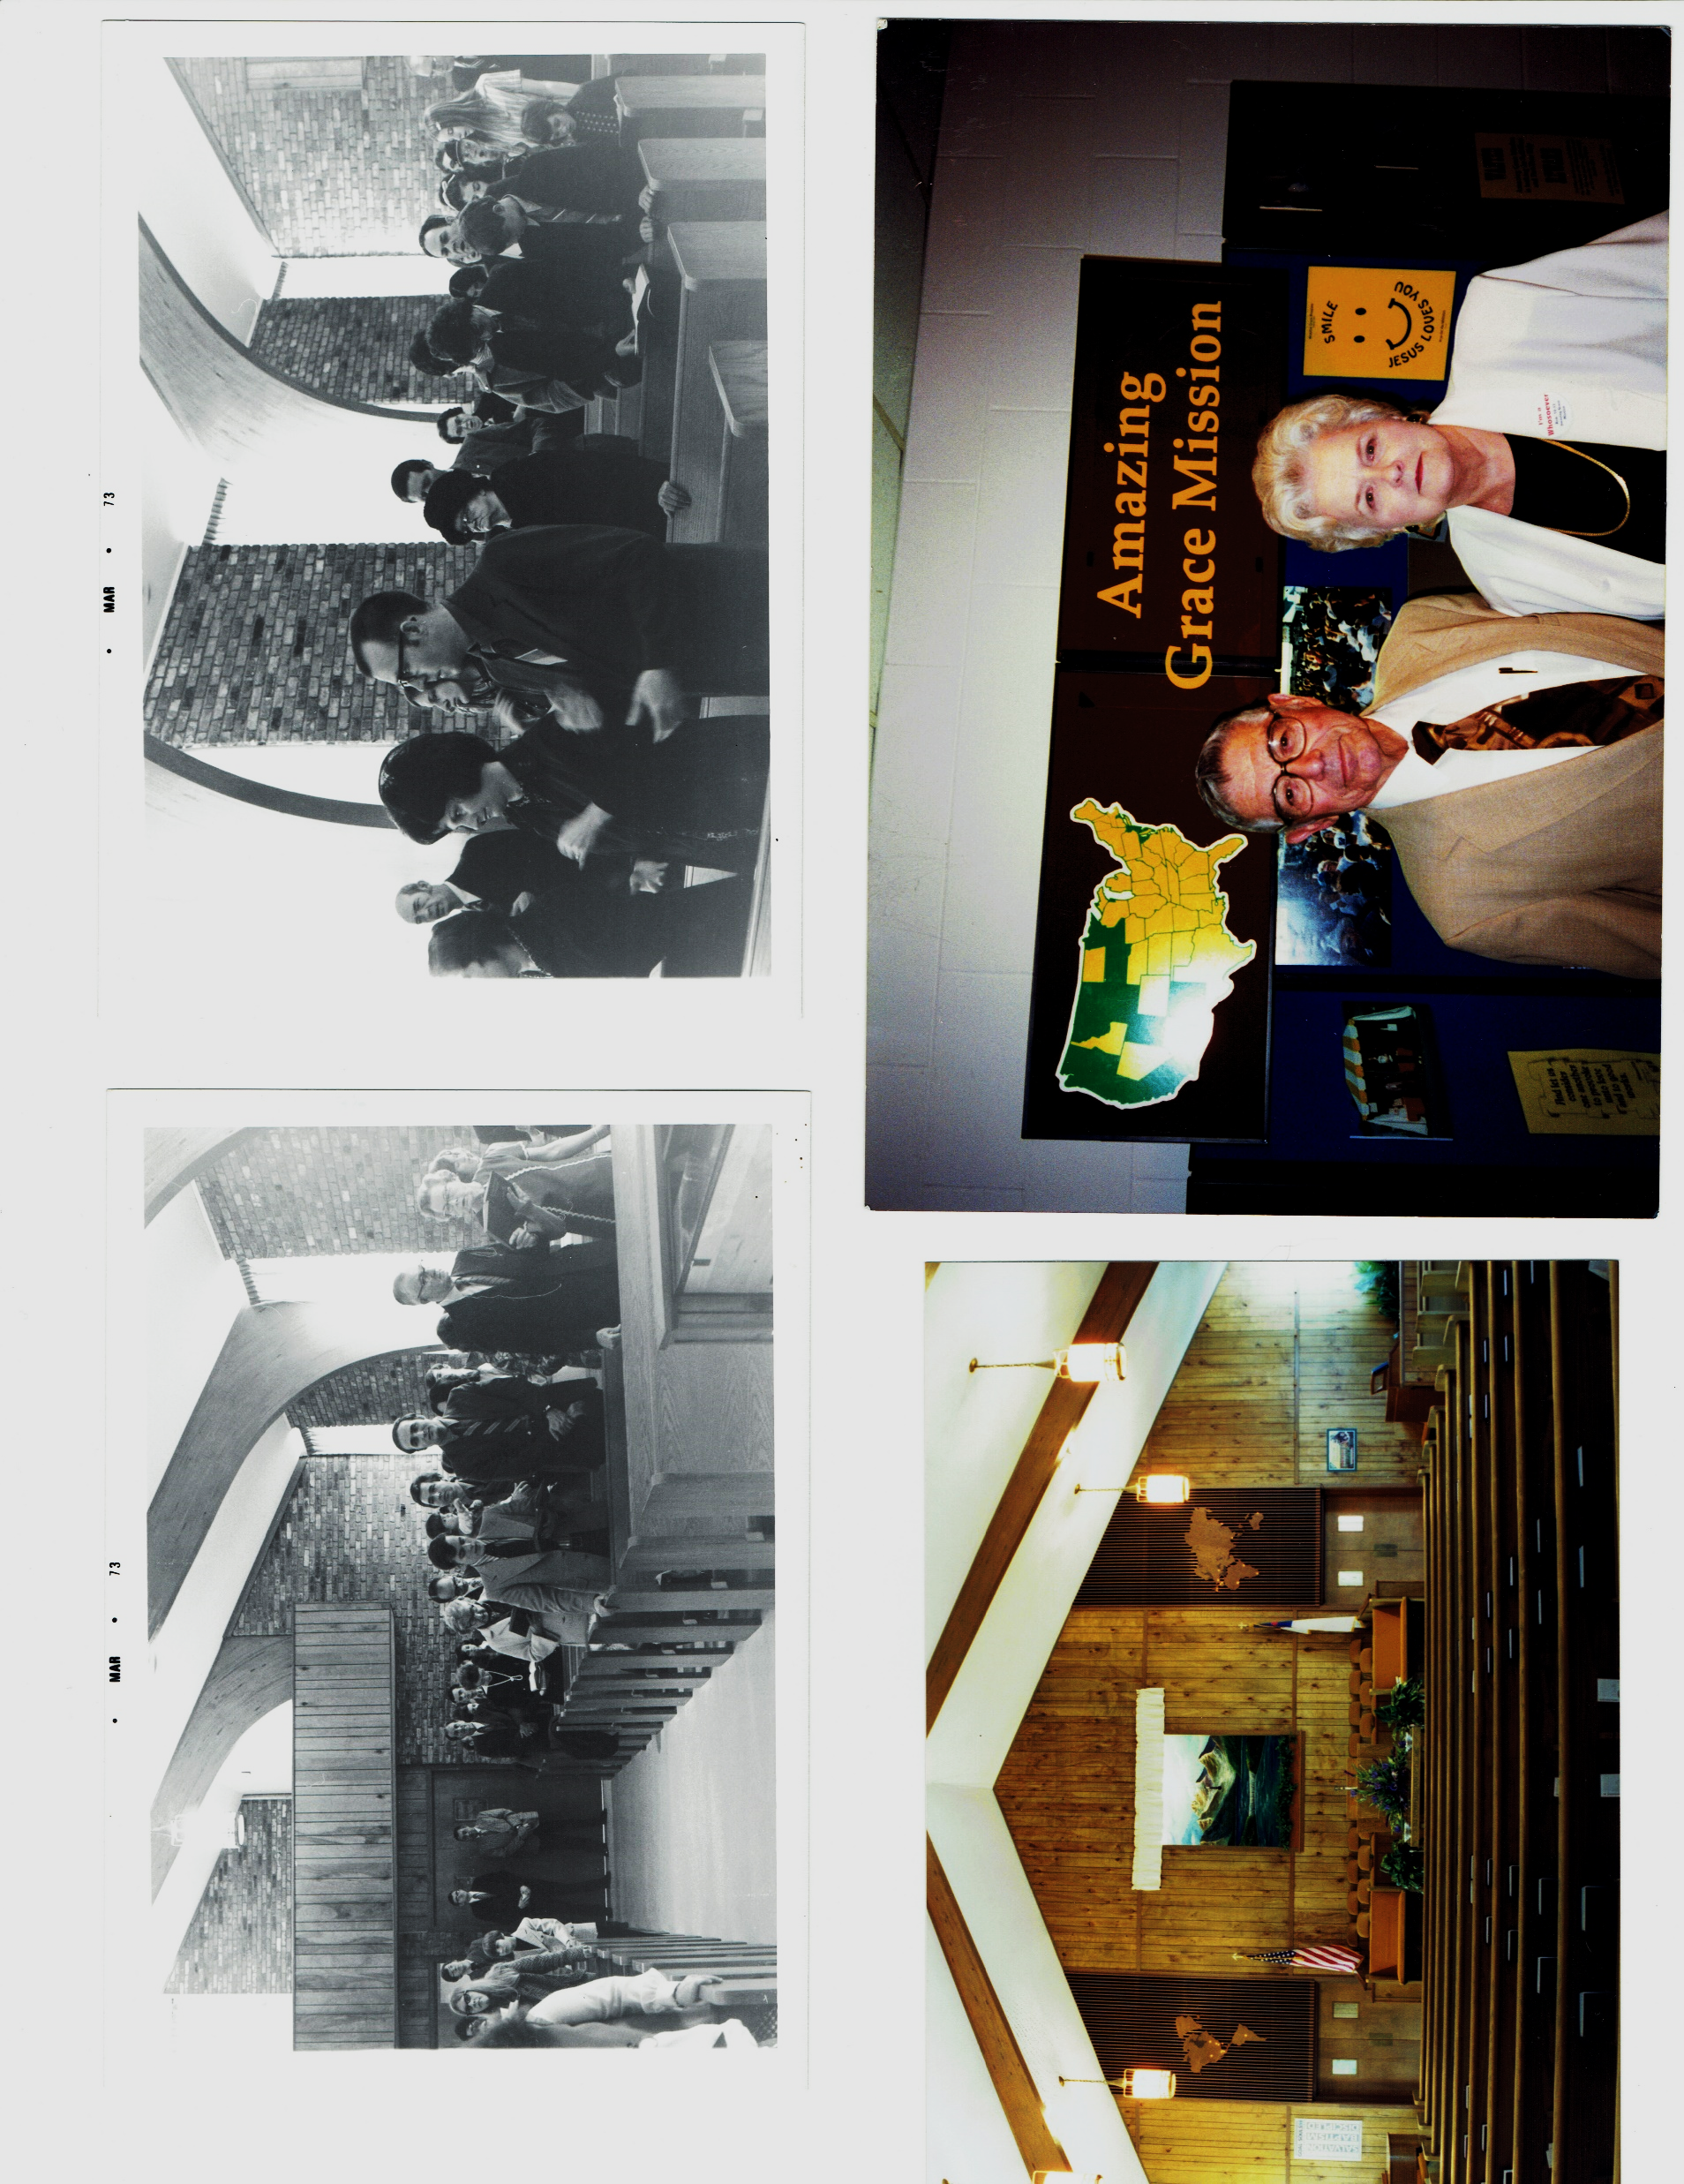
Auditorium with Open Balcony

Slide 14
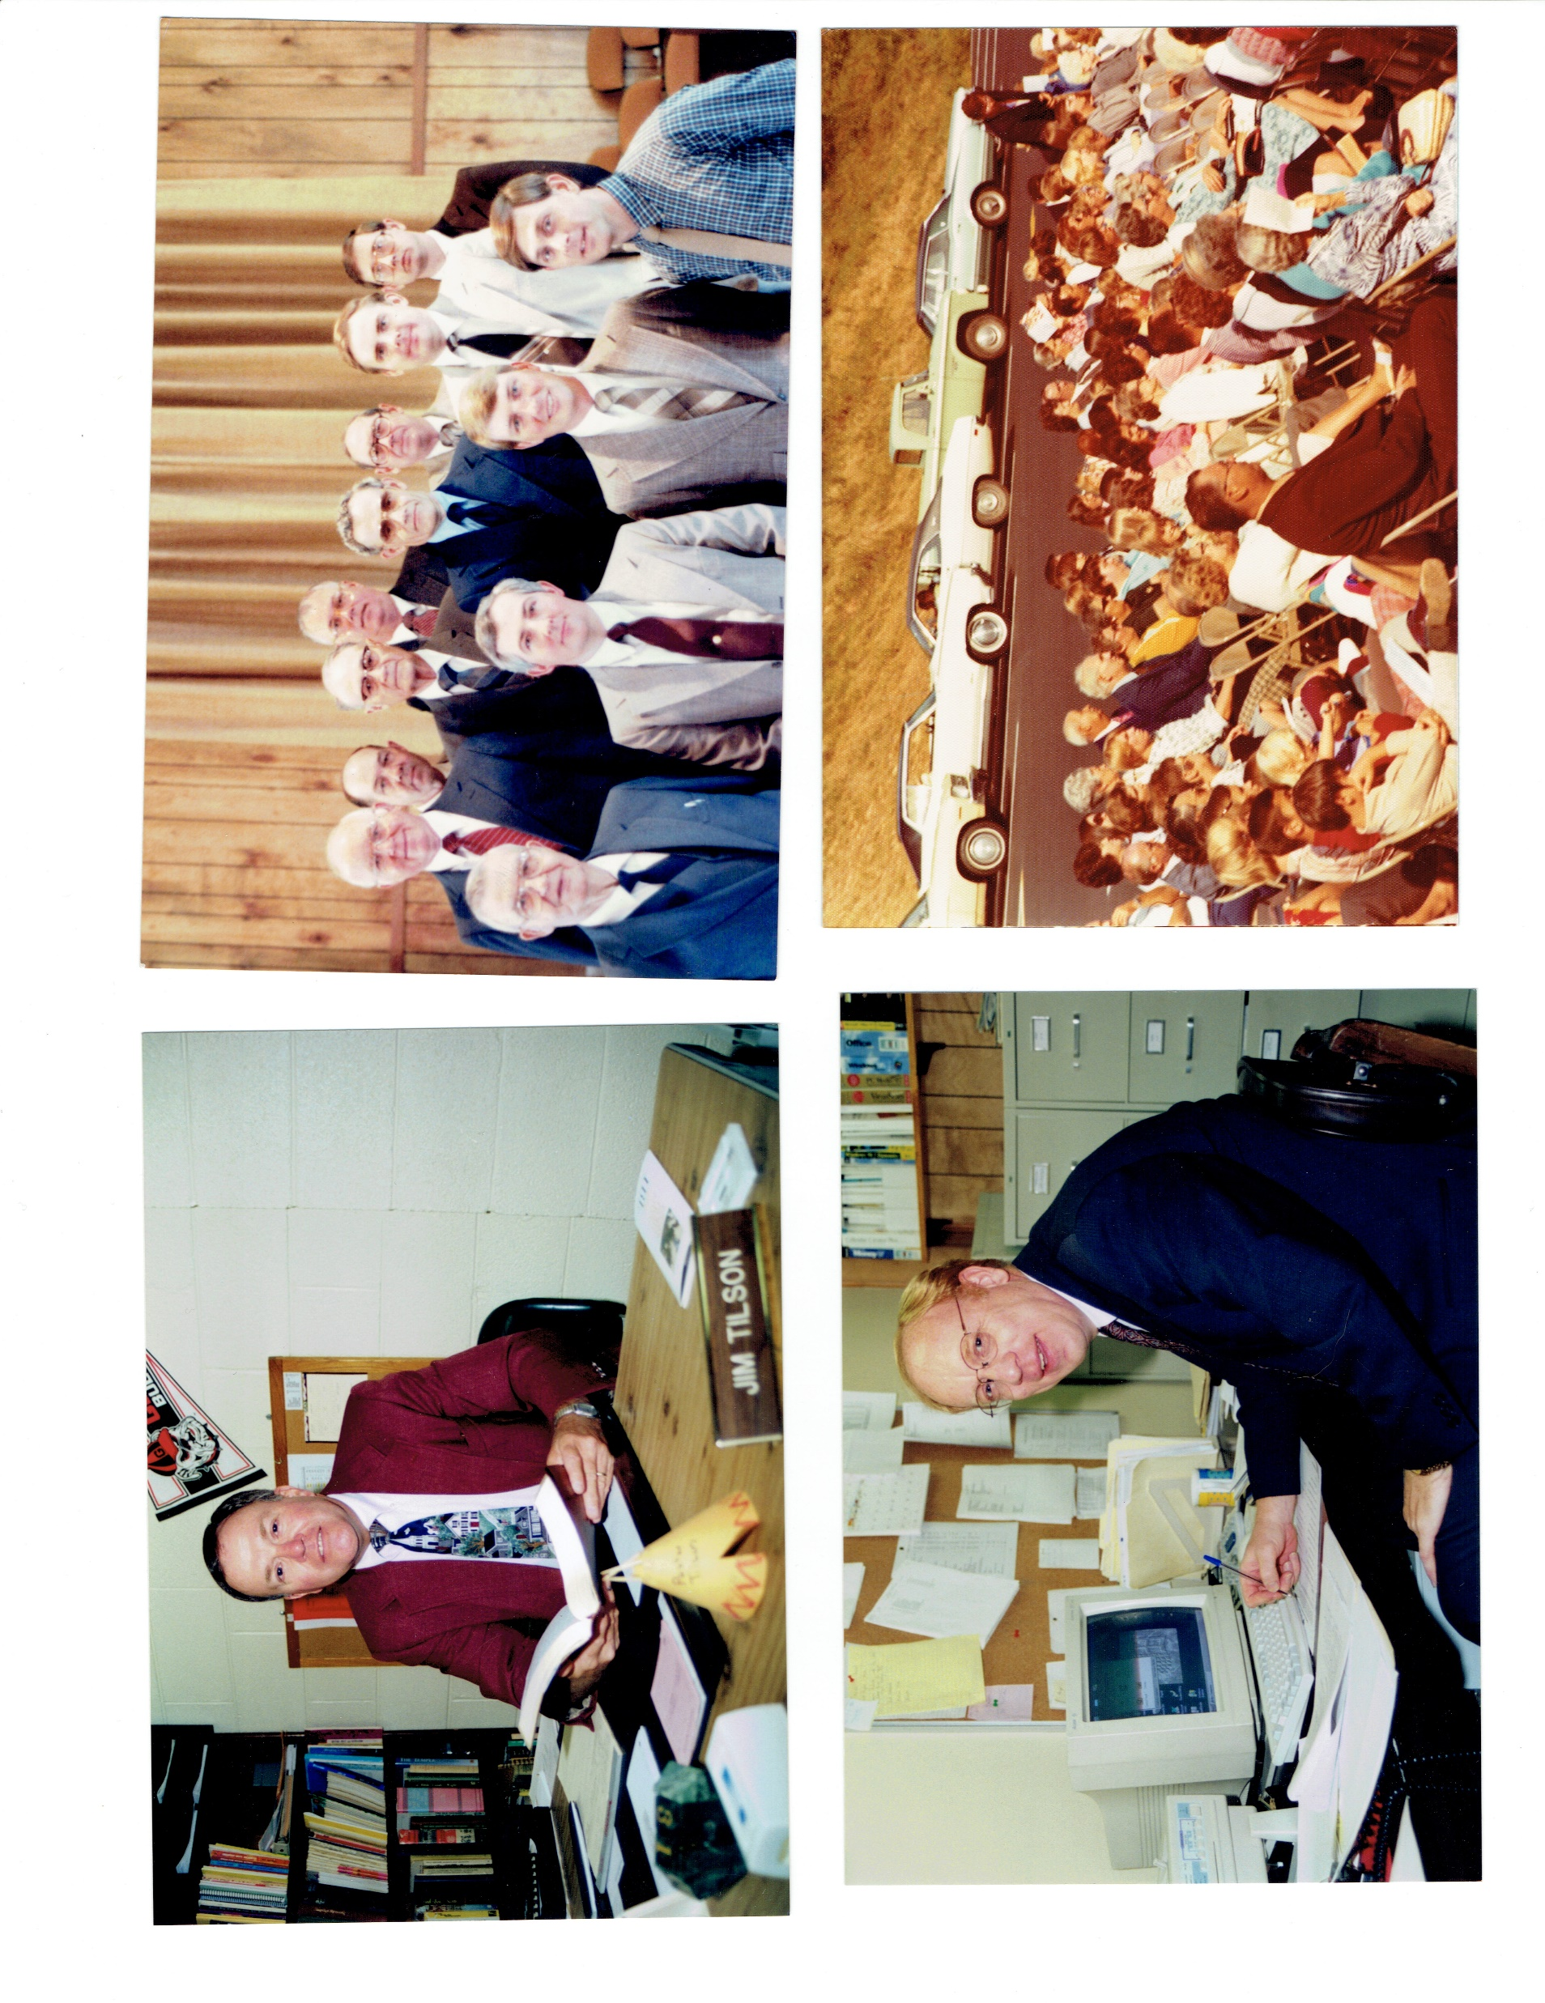
Church Service
Outside

Slide 15
Church Service
Outside

Slide 16
Deacons

Slide 17
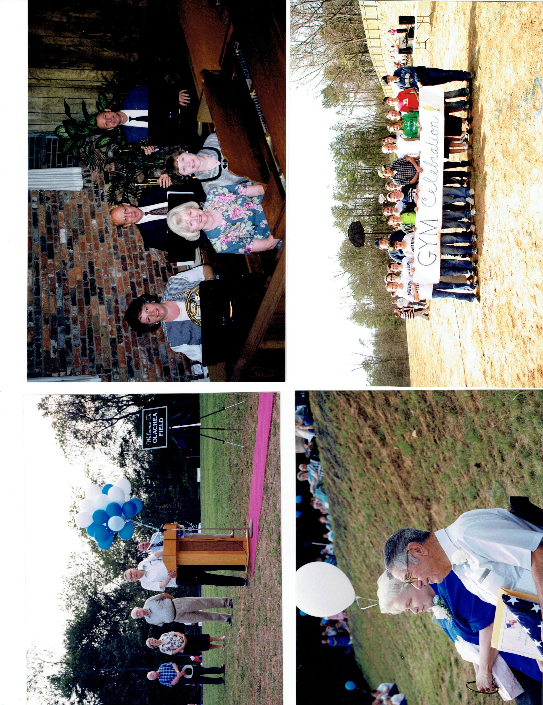
Musicians

Slide 18
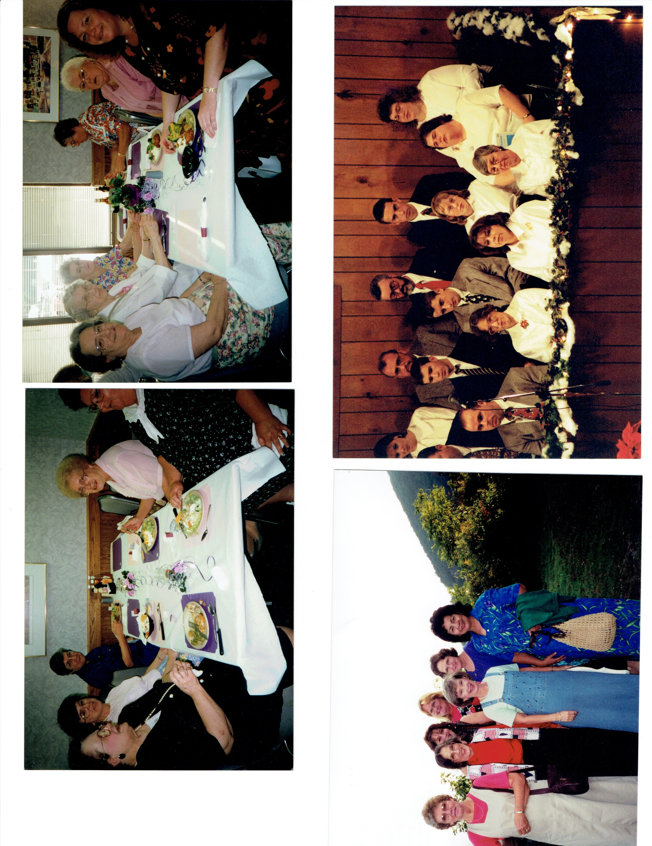
Ladies’ Activity

Slide 19
Ladies’ Activity

Slide 20
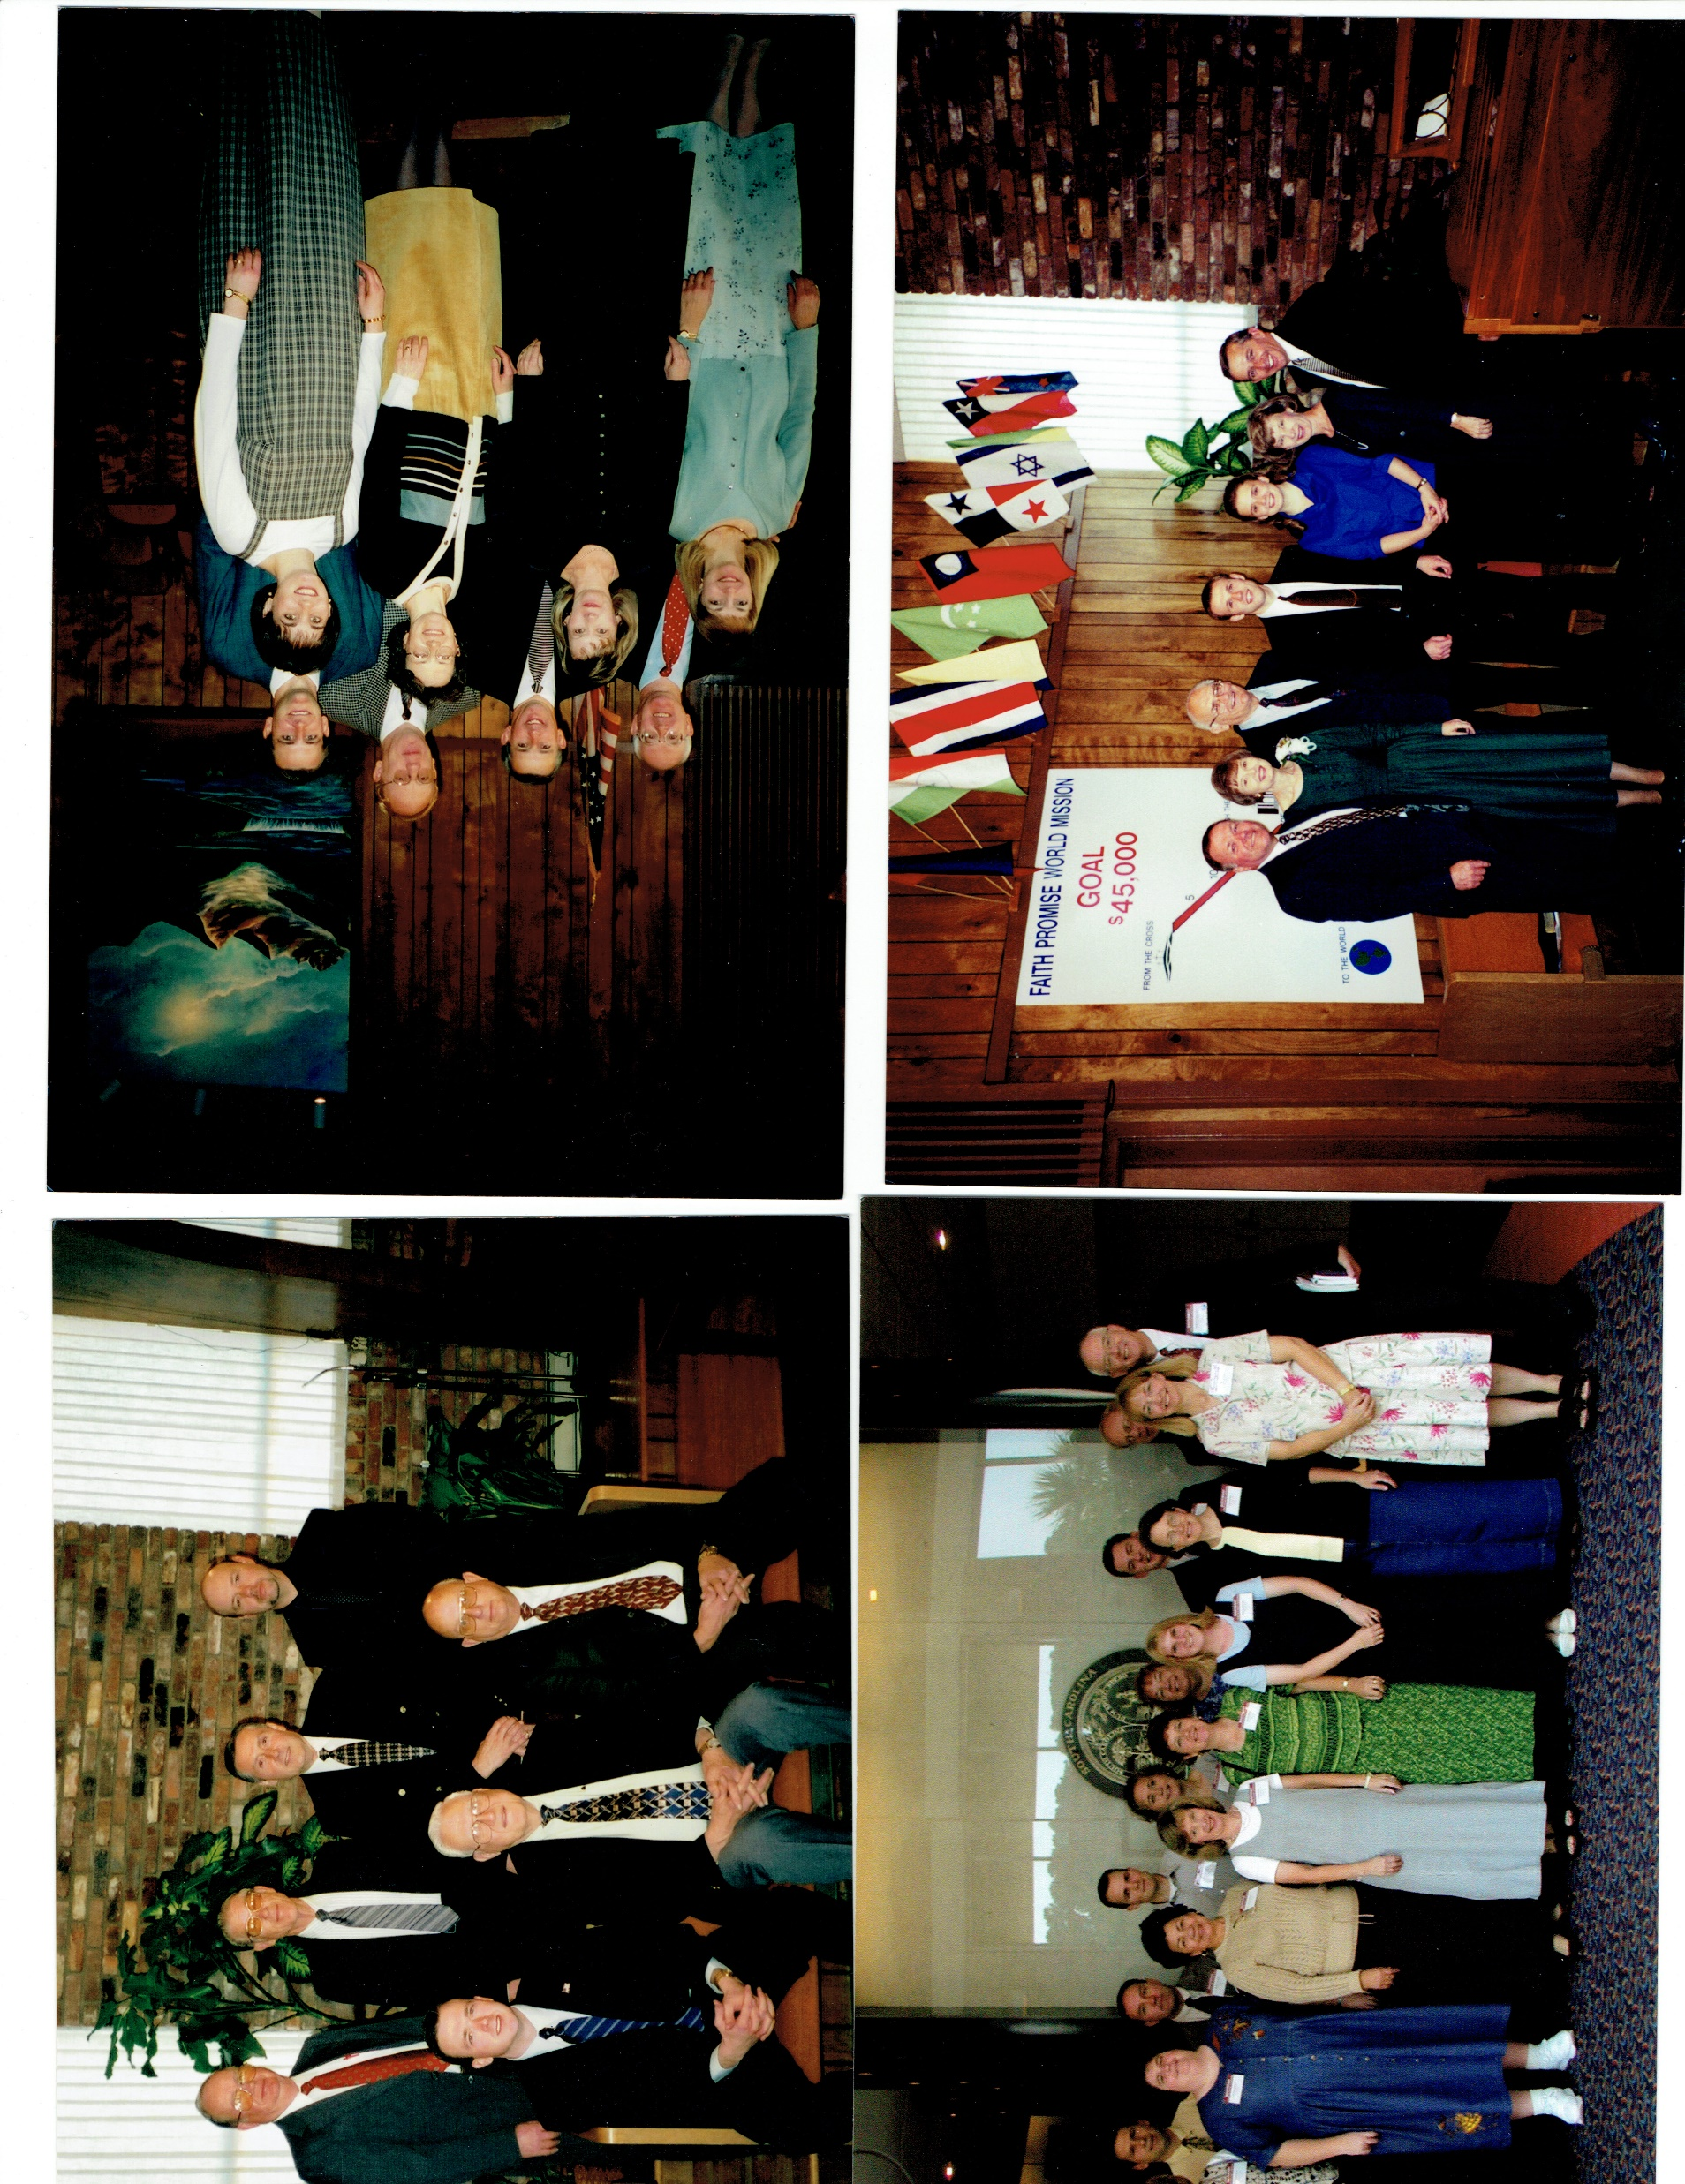
Missions Conference

Slide 21
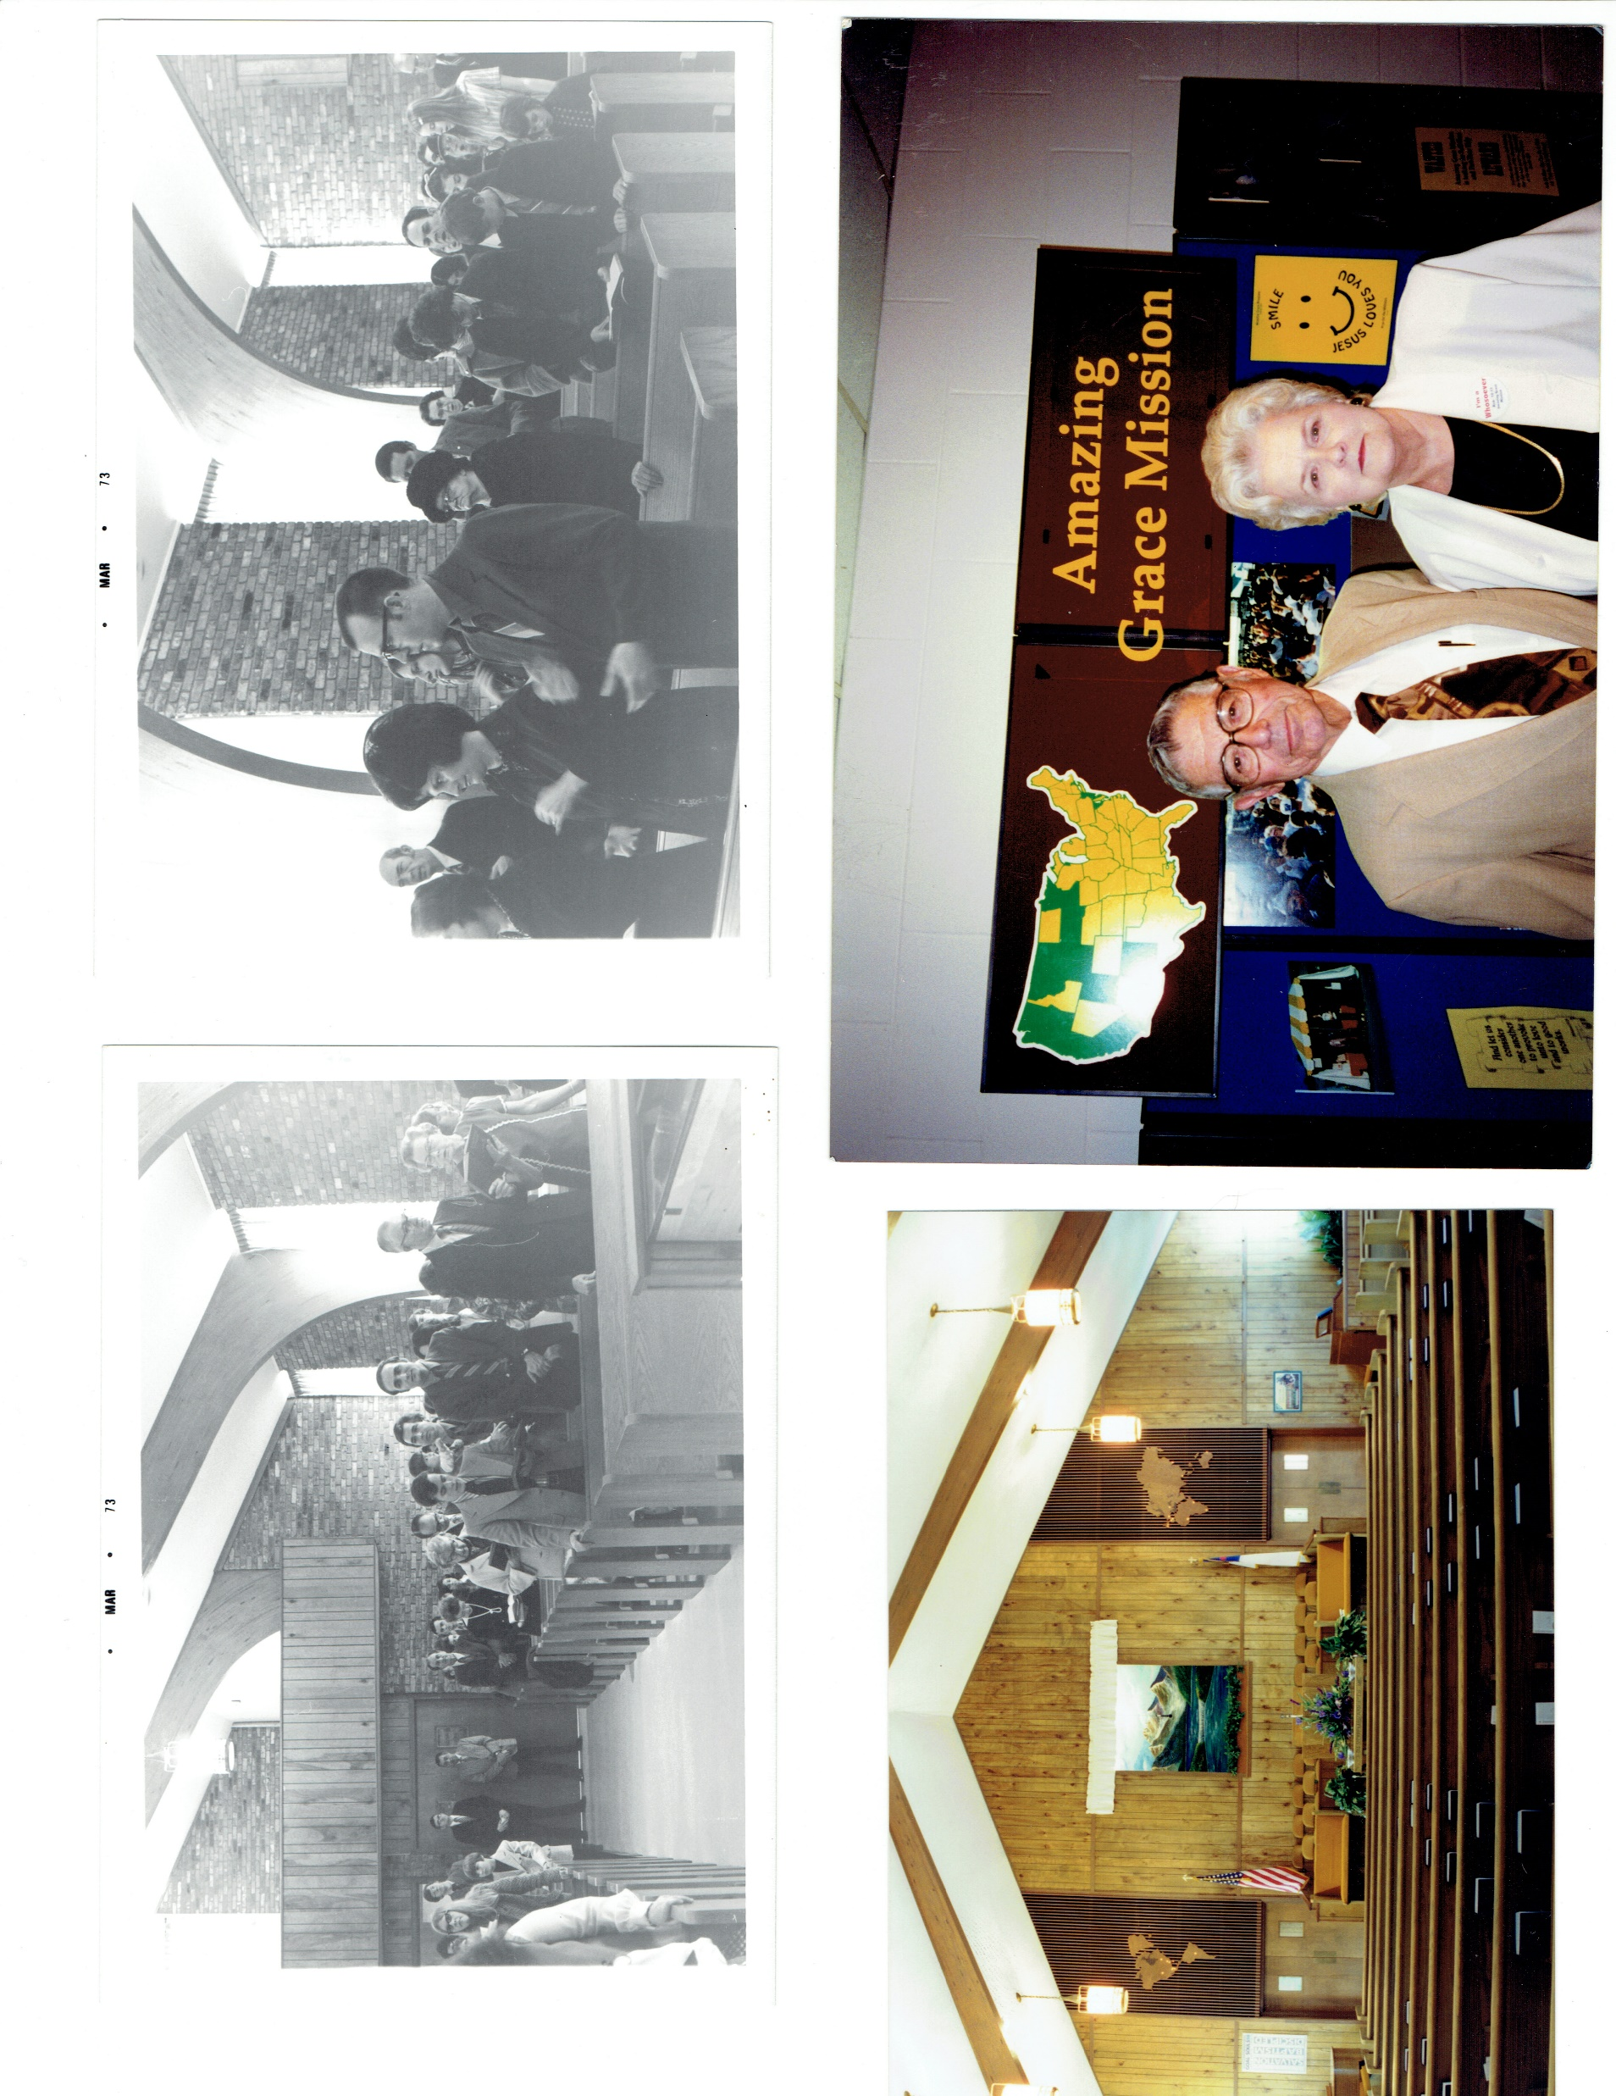
Missions Conference

Slide 22
Christmas Cantata

Slide 23
Deacons
Church Staff

Slide 24
Church Staff

Slide 25
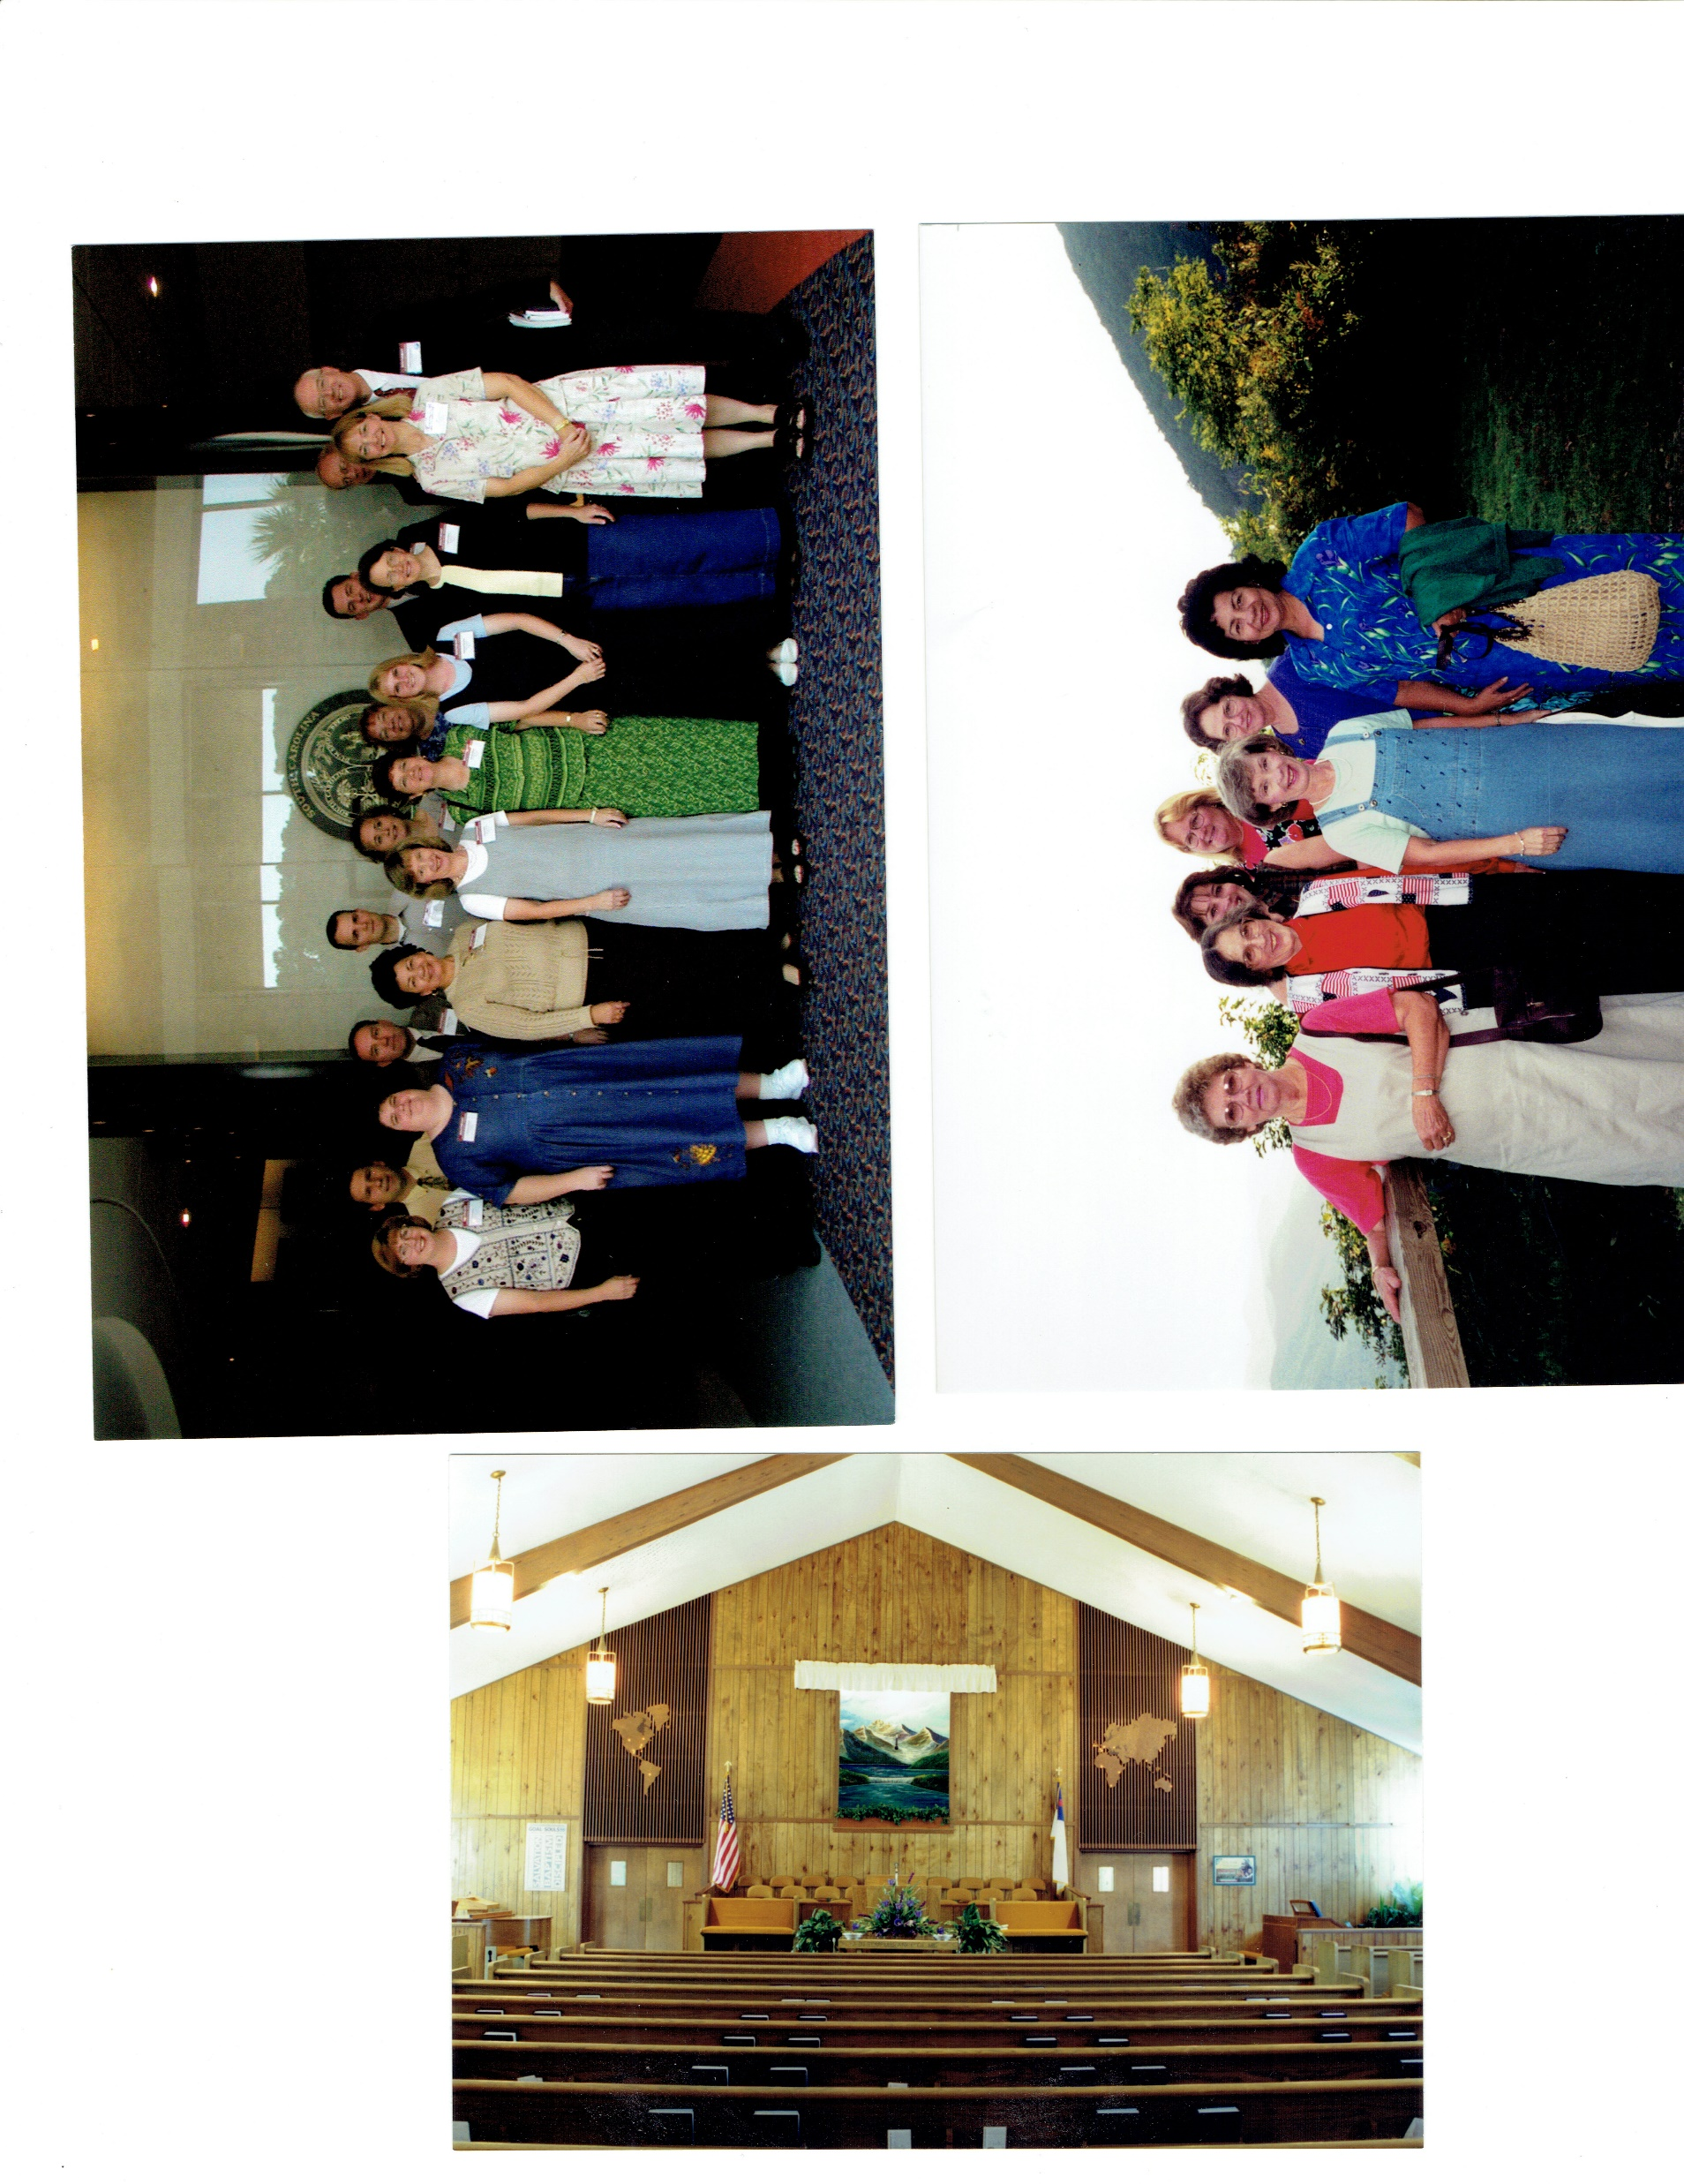
Pre-Renovation Auditorium

Slide 26
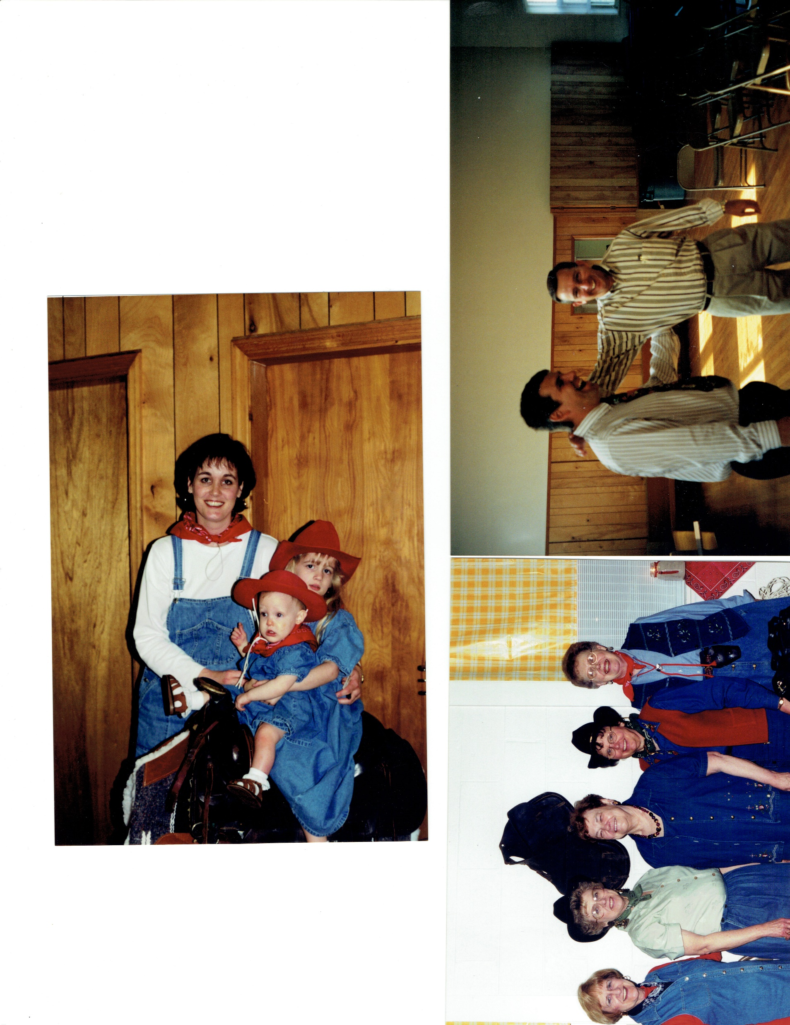
Ladies’ Banquet

Slide 27
Ladies’ Activity at
Pisgah Inn

Slide 28
Olachea Field Dedication
Ceremony

Slide 29
Pastor
and Mrs. Olachea at the Field Dedication
Ceremony

Slide 31
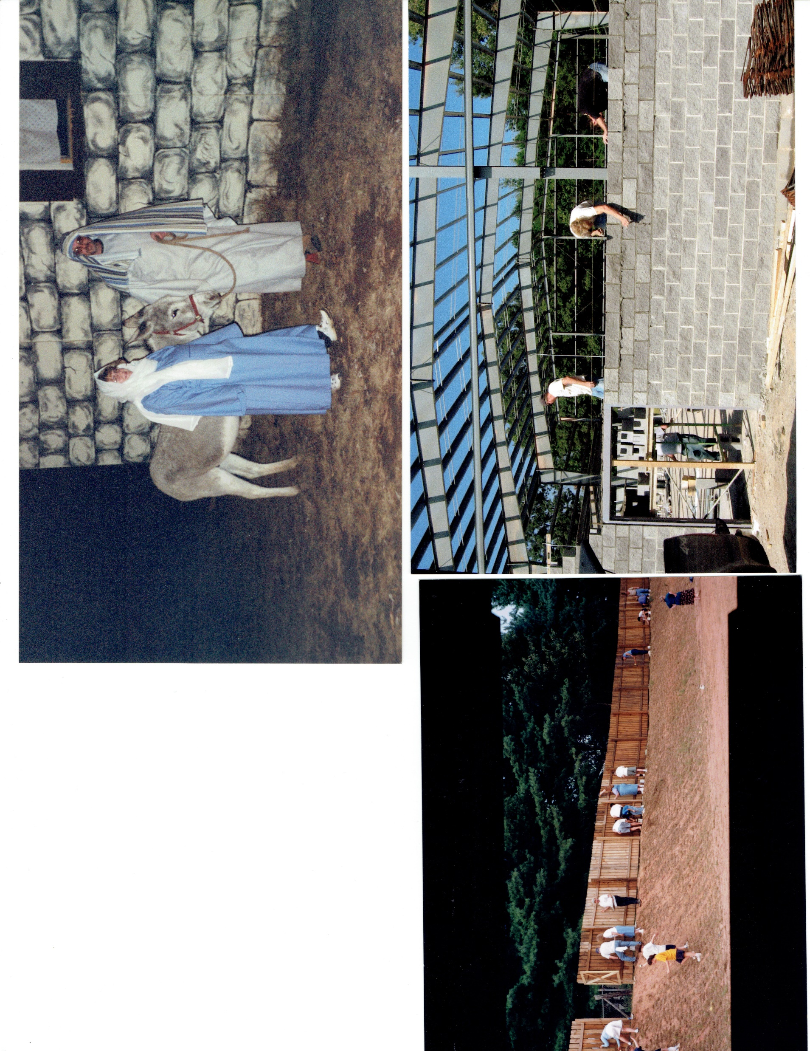
Work Day at the Field

Slide 32
Gymnasium Construction

Slide 33
Patch the Pirate Club

Slide 34
Youth Group

Slide 35
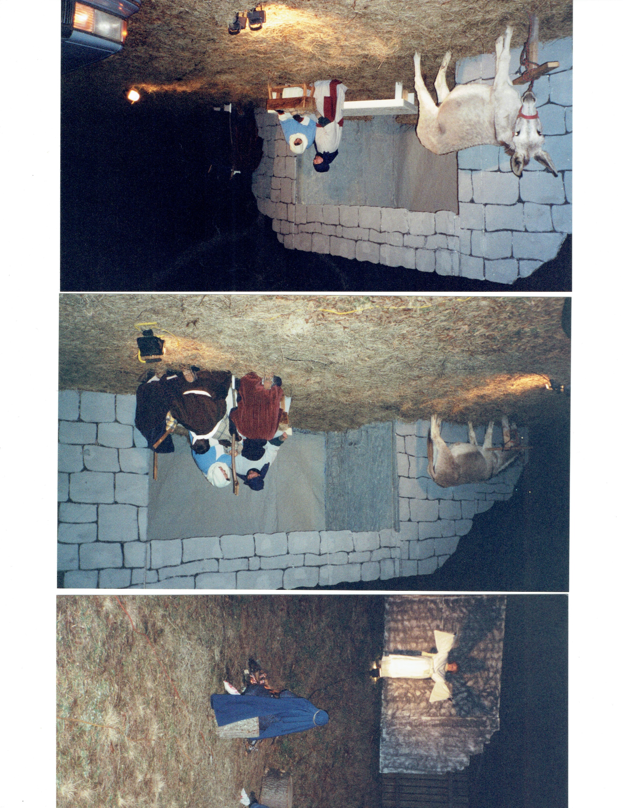
Drive-through Live Nativity Scene

Slide 36
Drive-through Live Nativity Scene

Slide 37
Teachers’ Convention

Slide 38
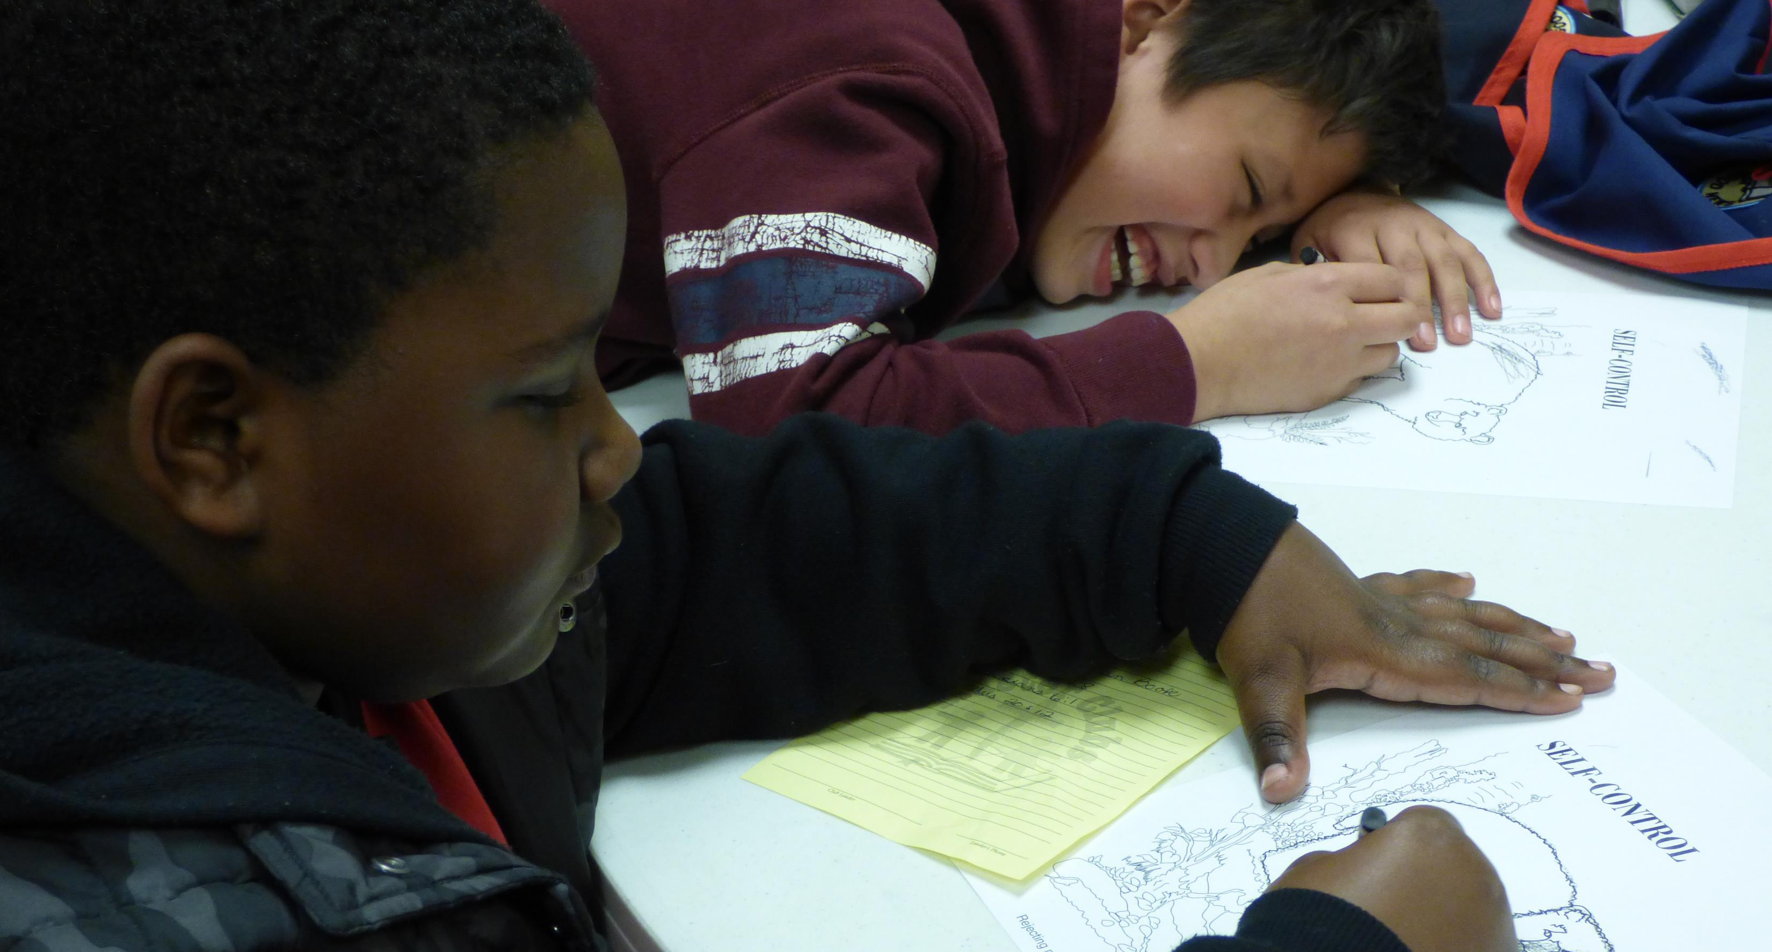
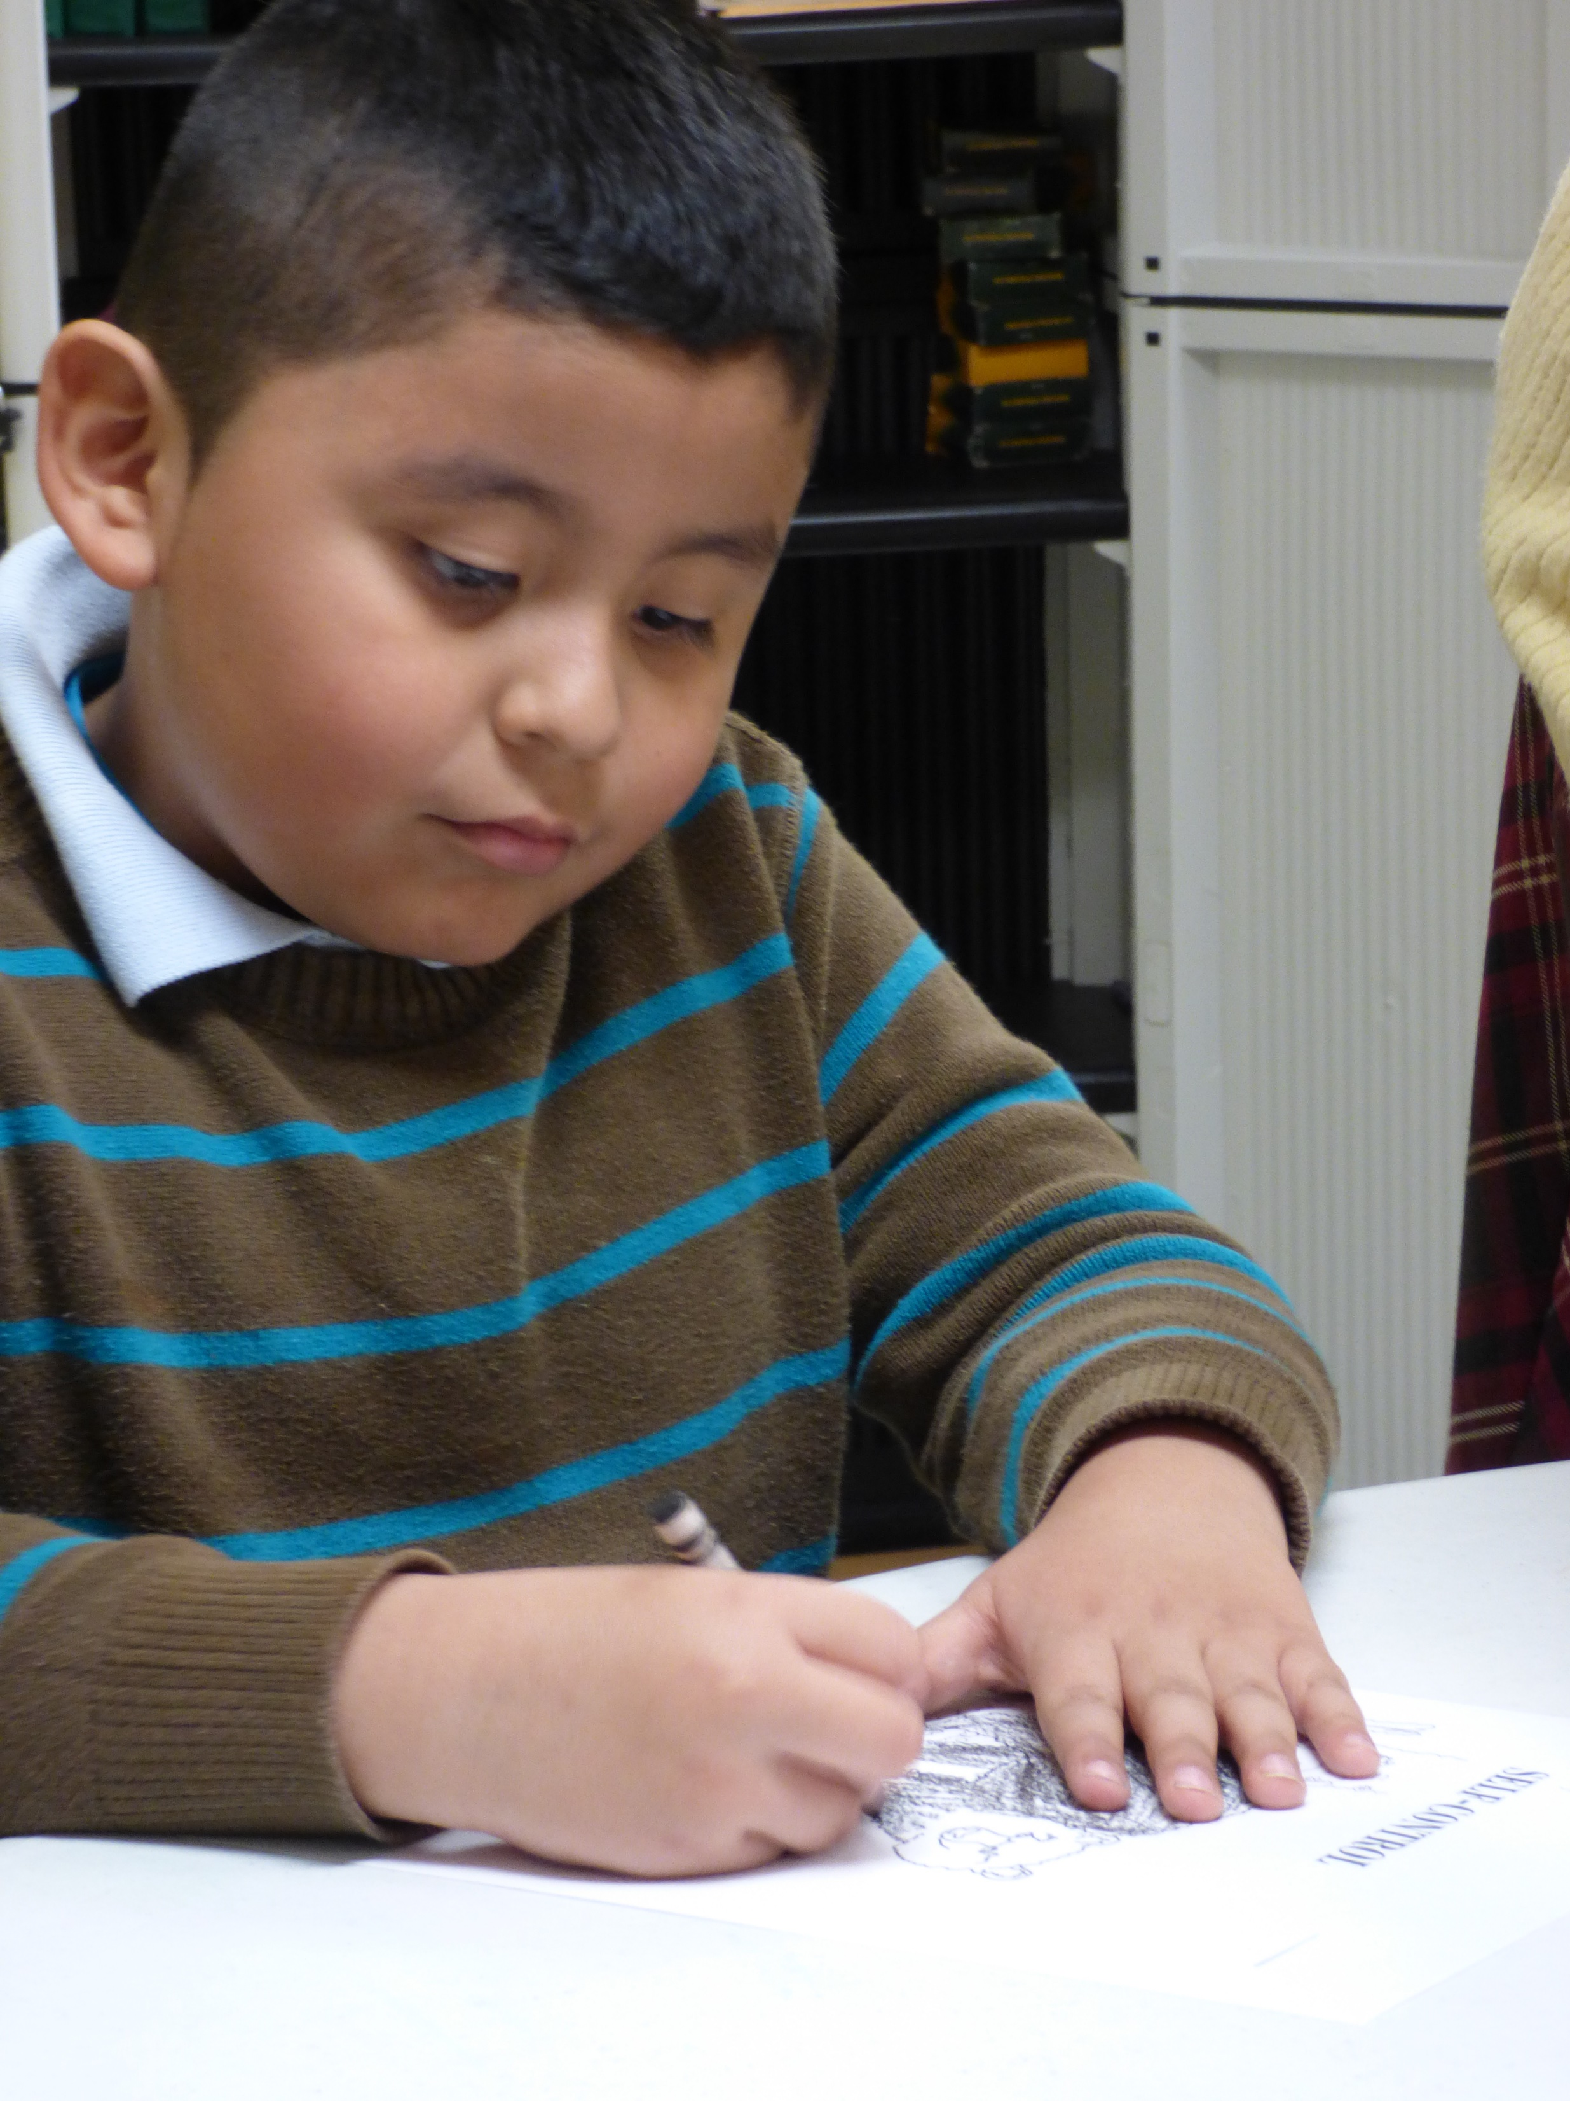
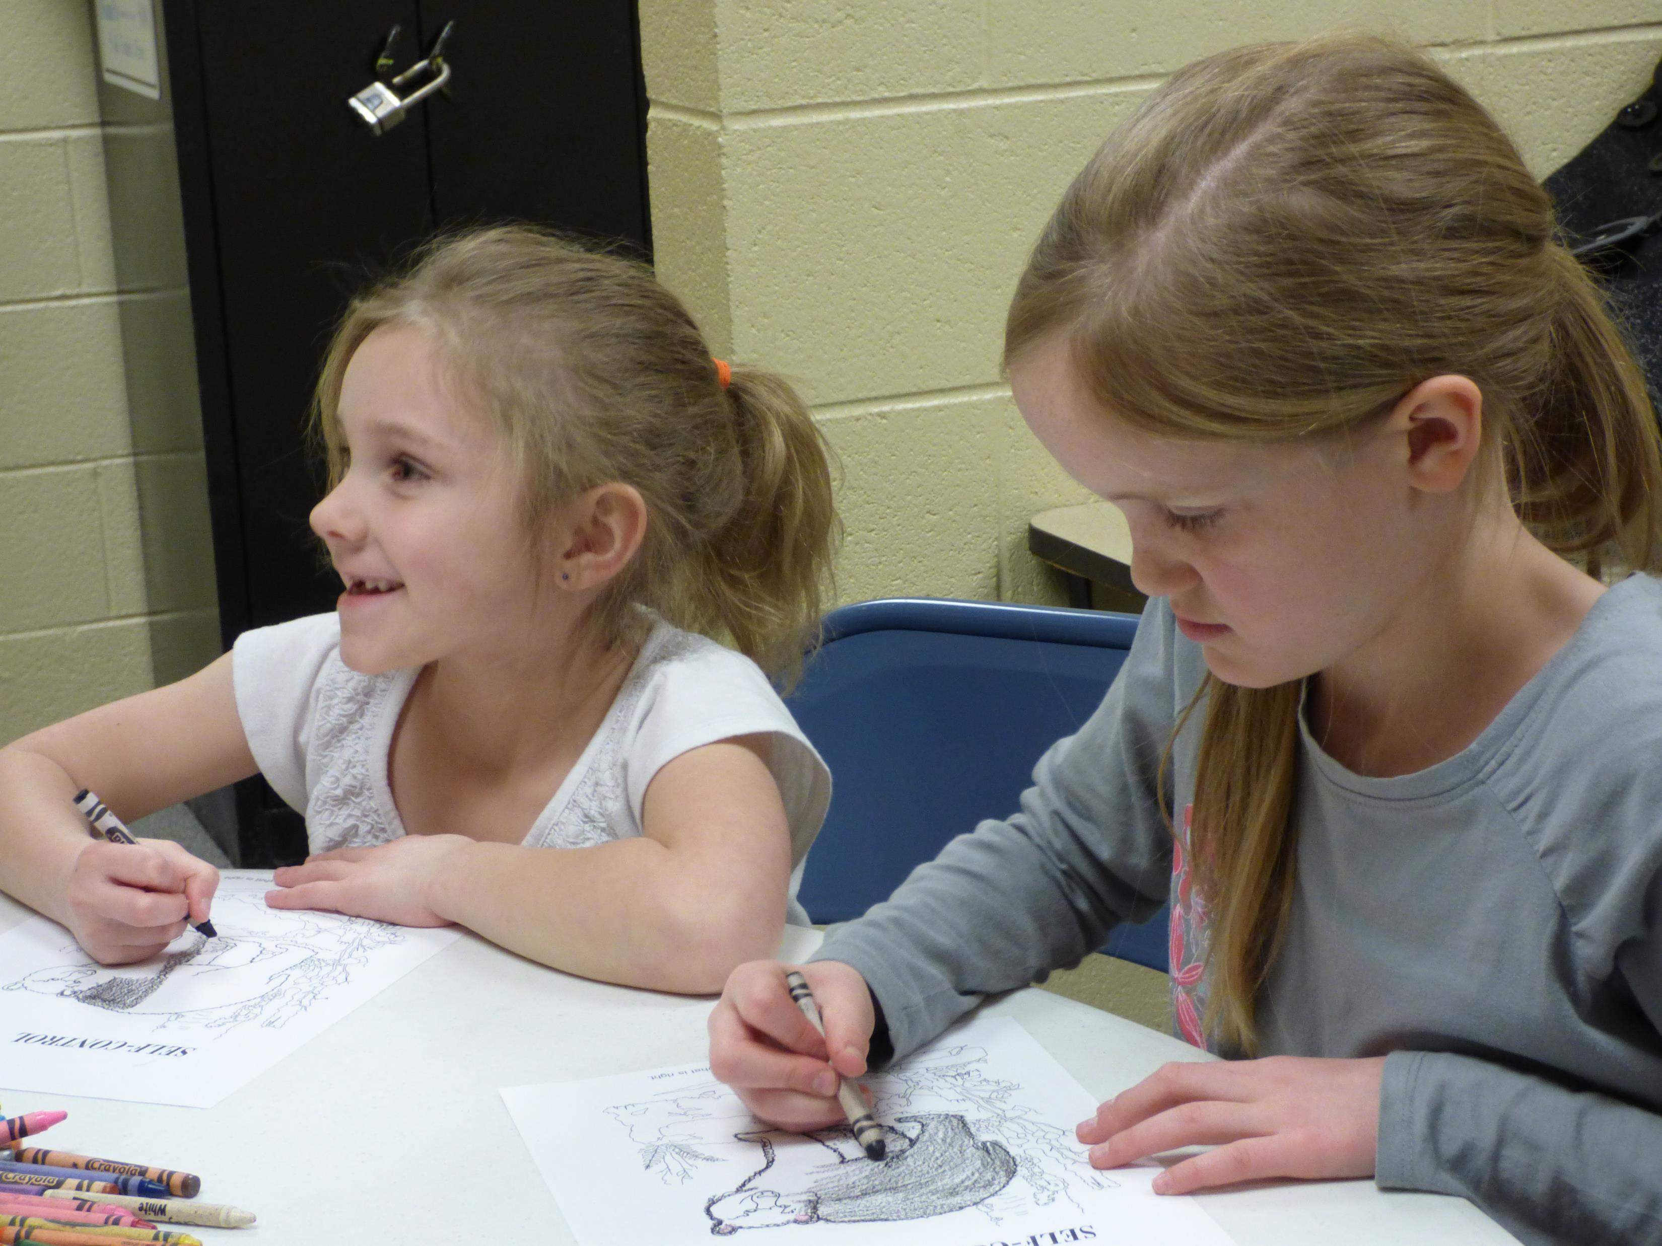
Master’s Club

Slide 39
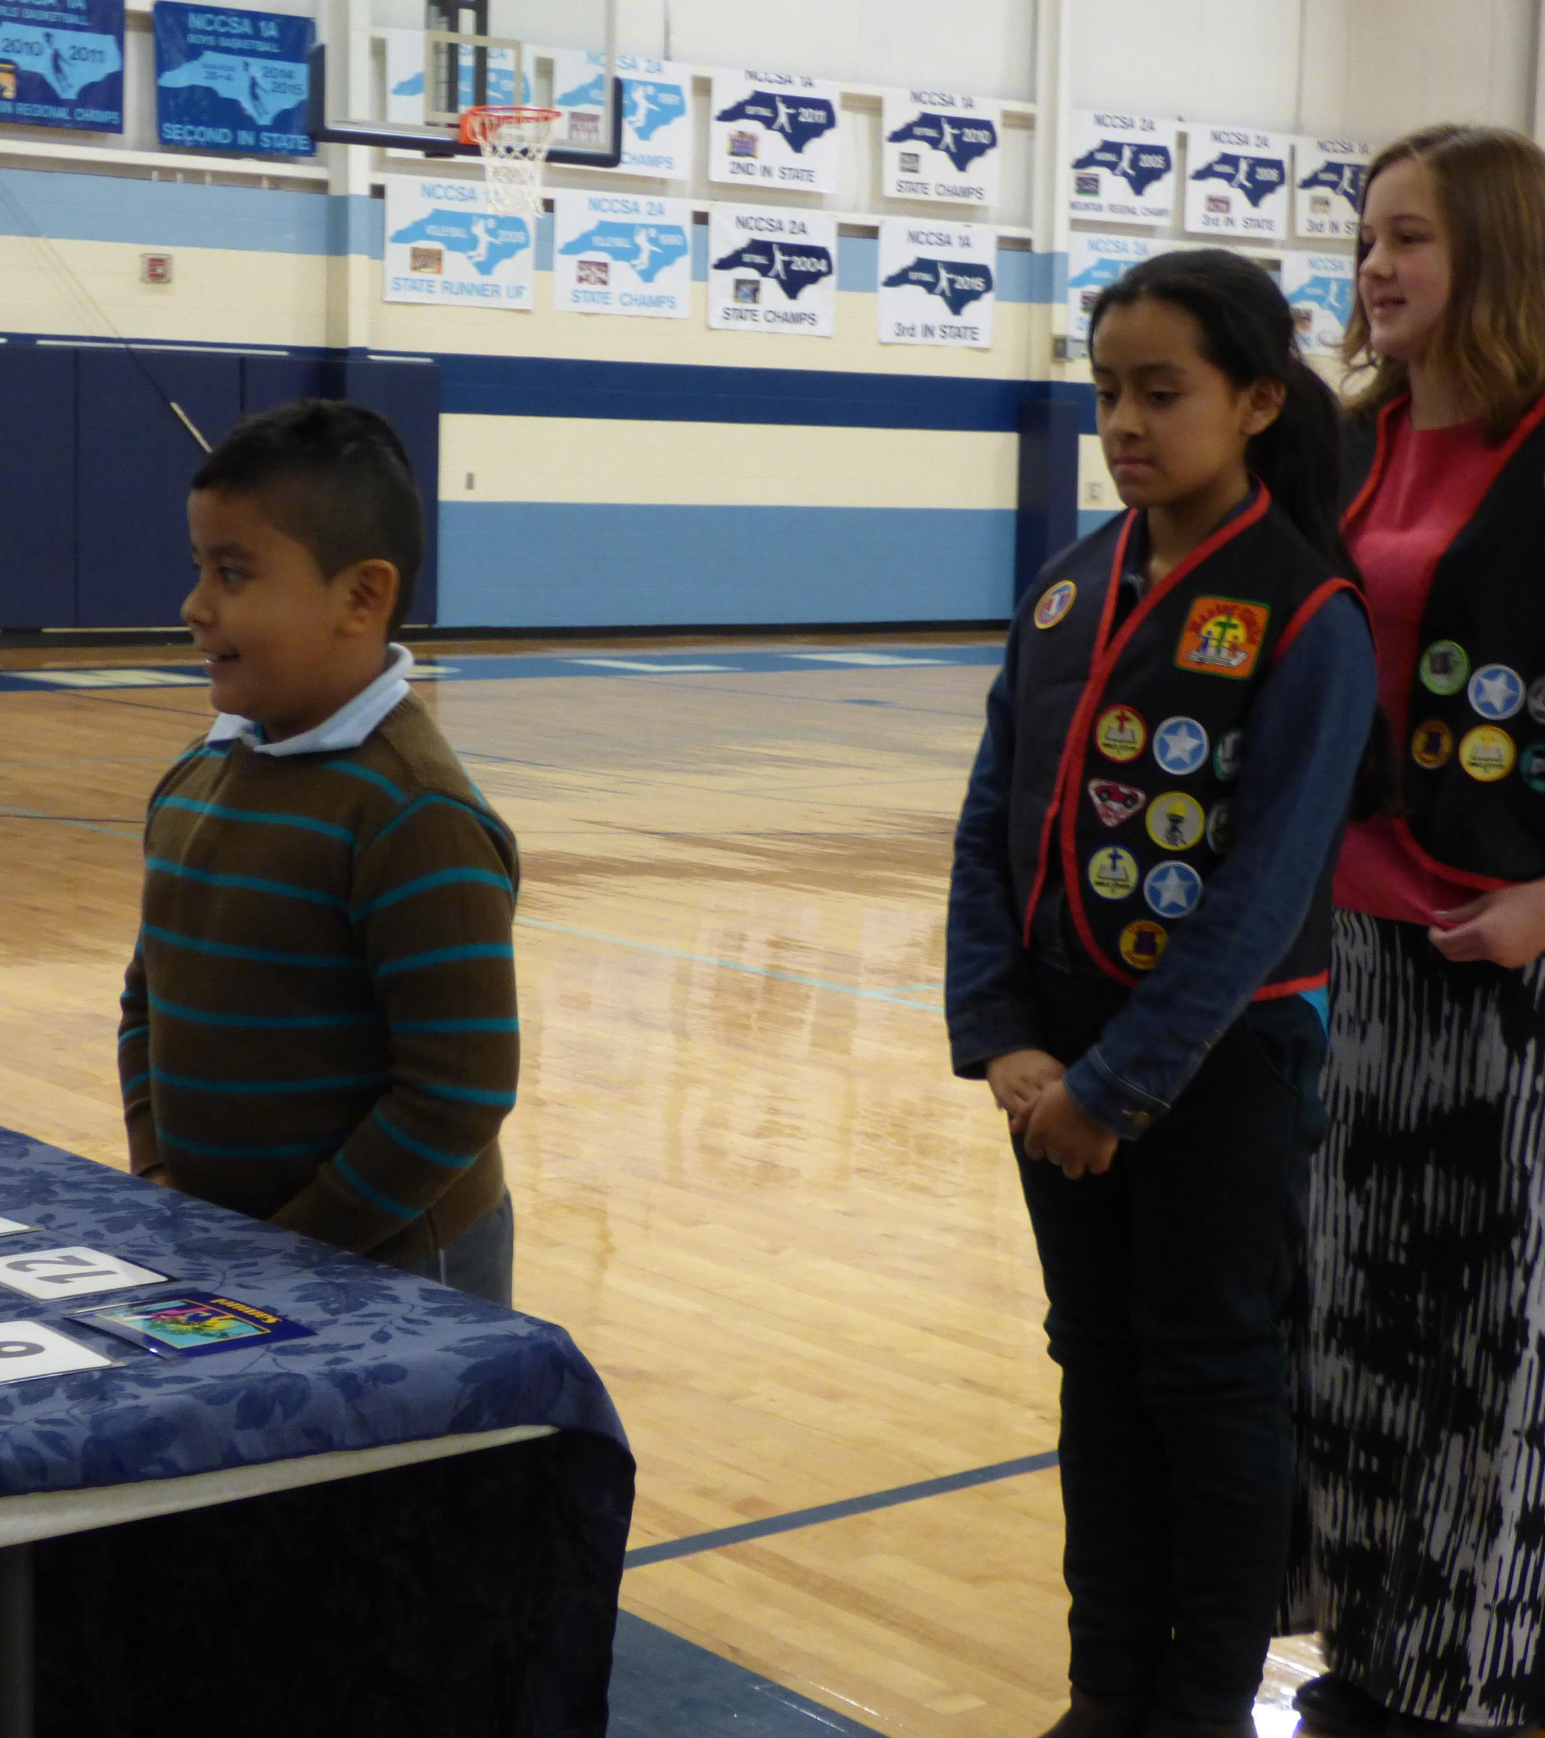
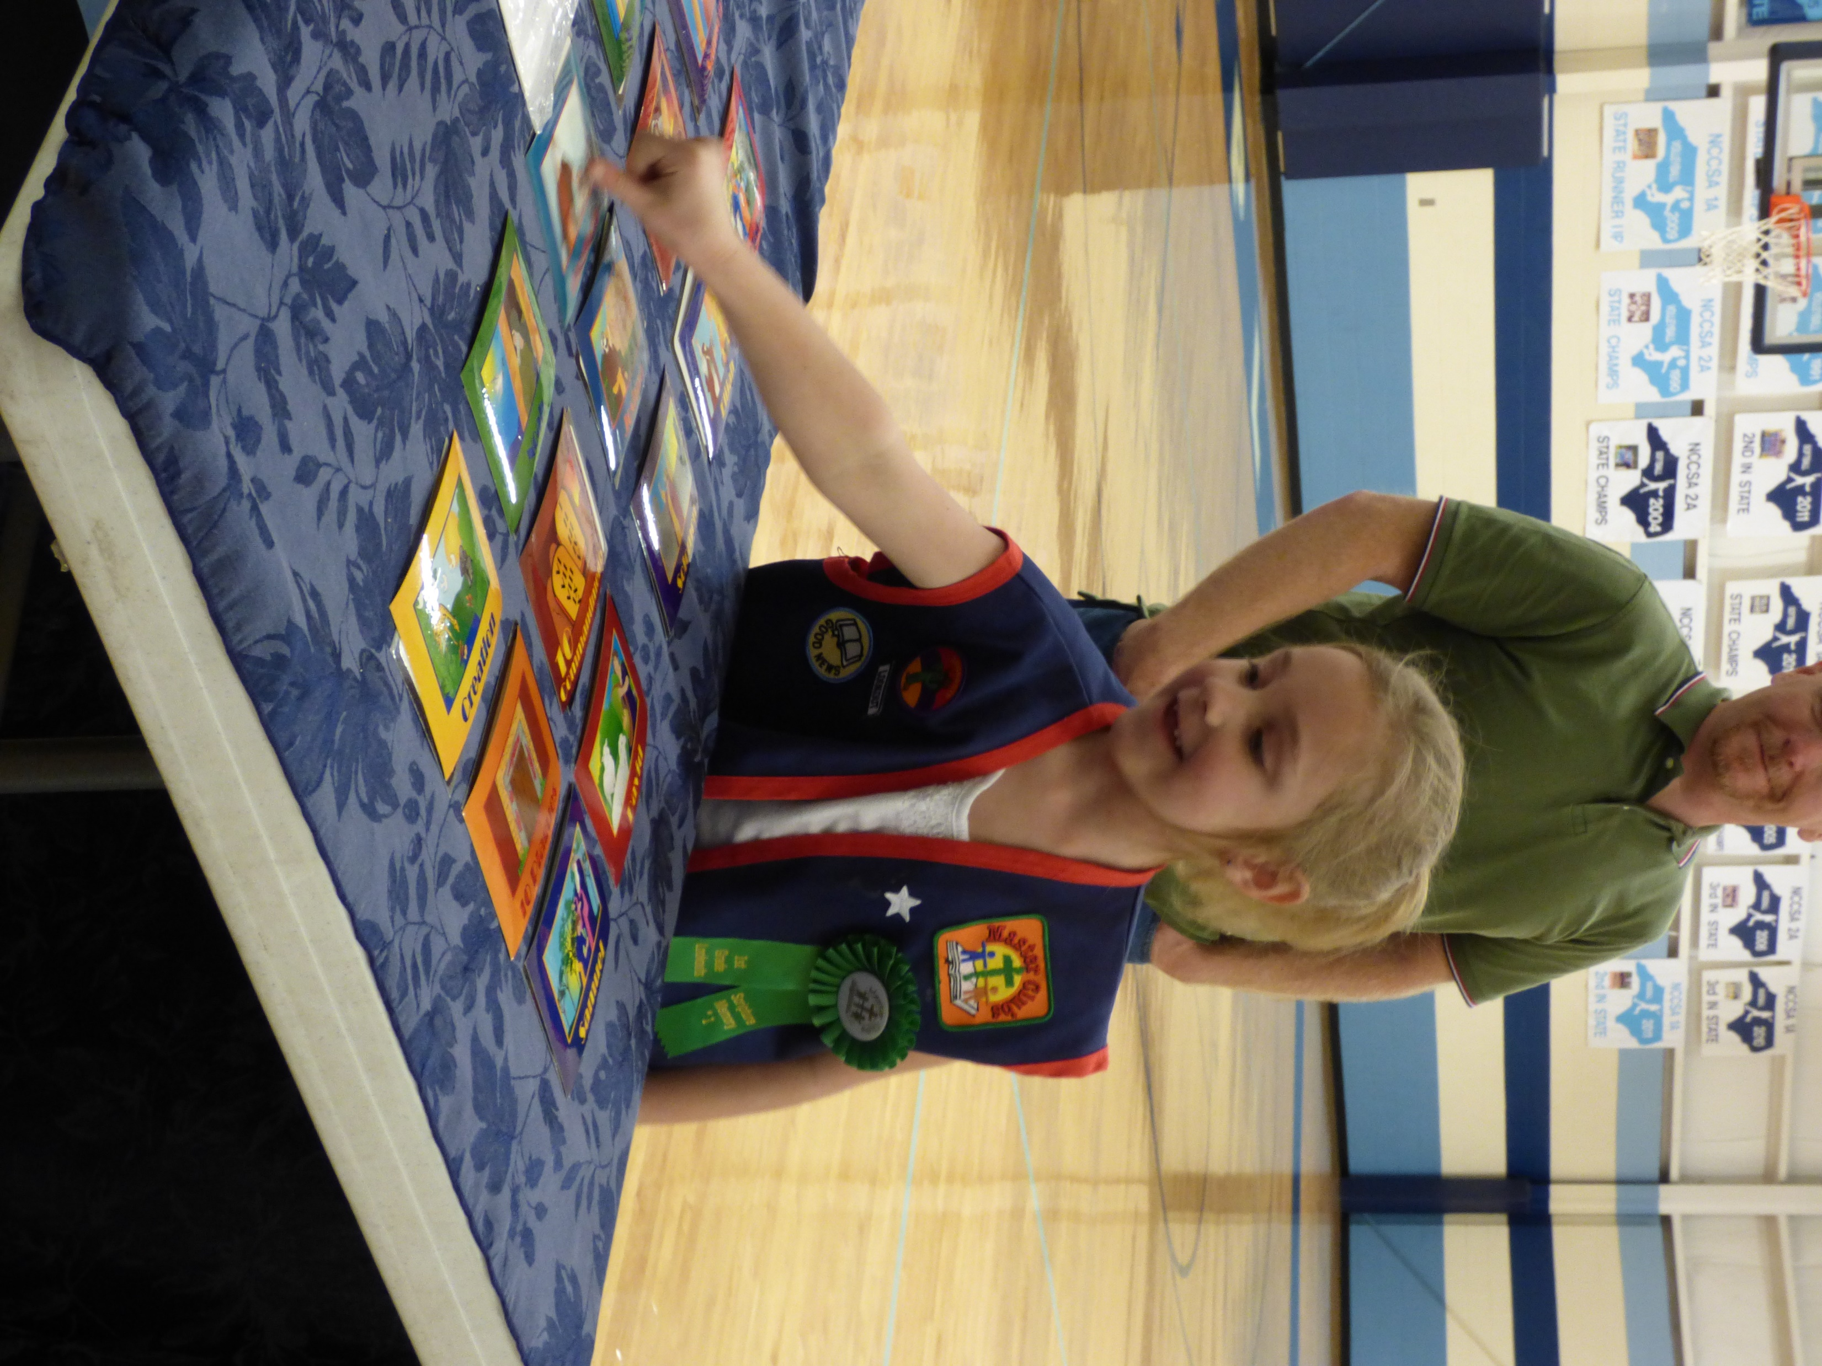
Master’s Club

Slide 40
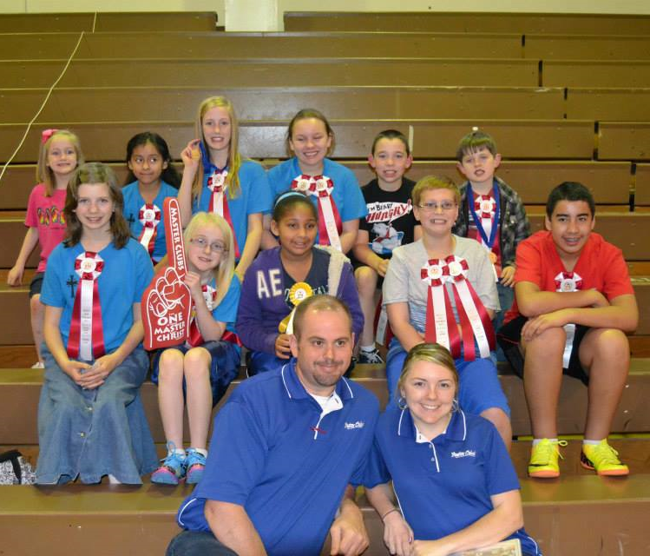
Master’s Club Regionals 2014

Slide 41
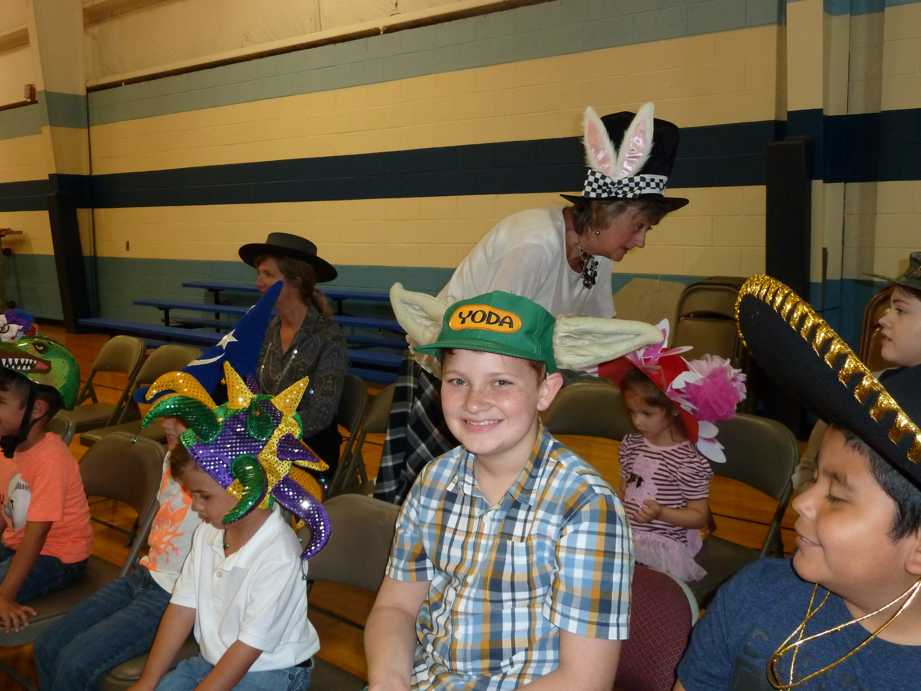
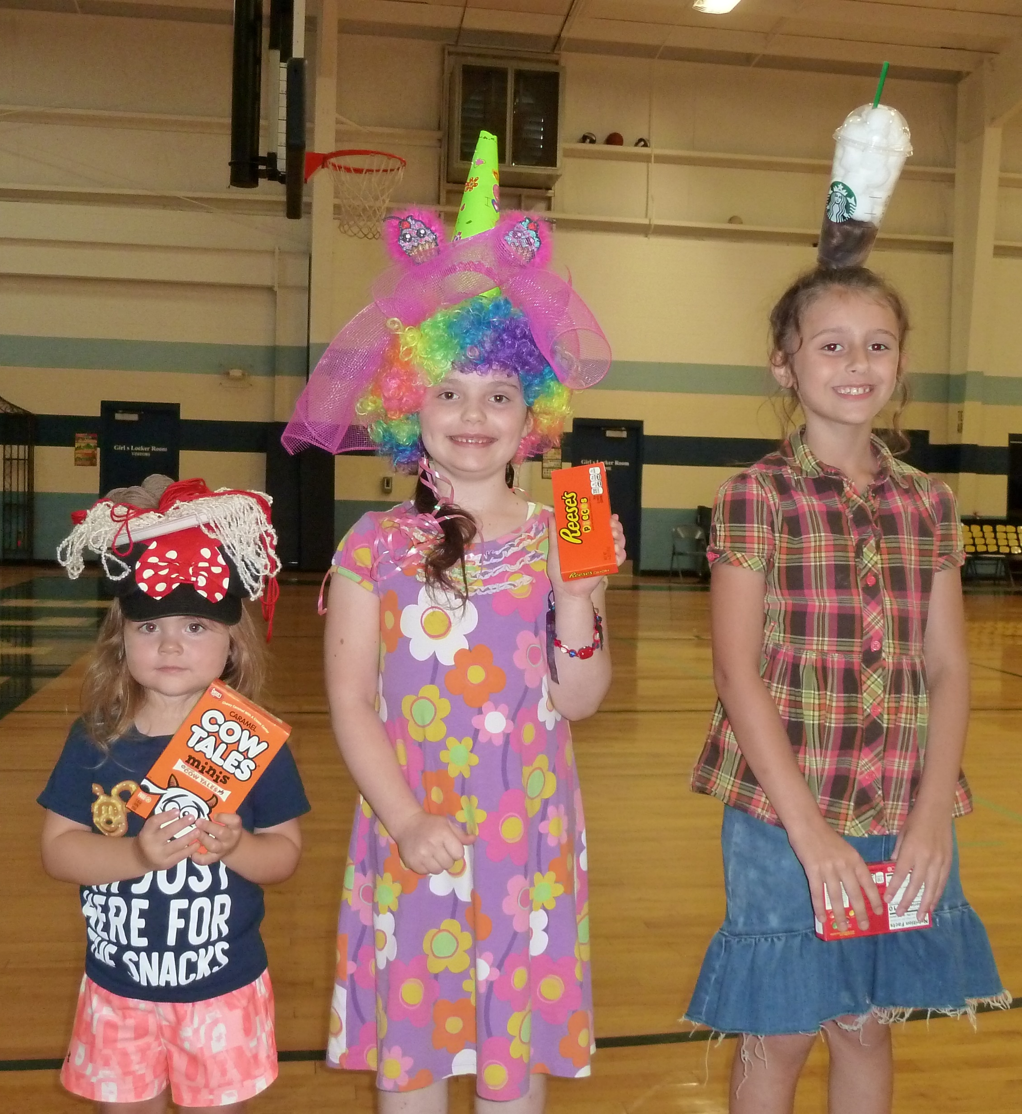
Crazy Hat Night
Master’s Club

Slide 42
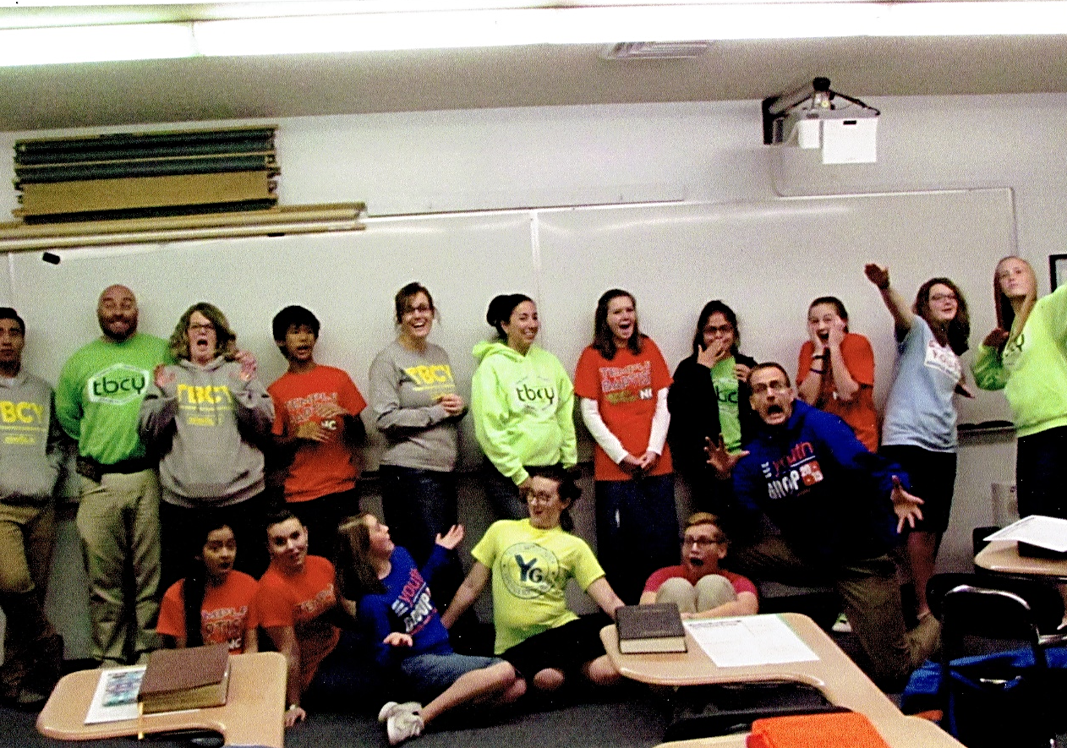
Youth Group

Slide 43
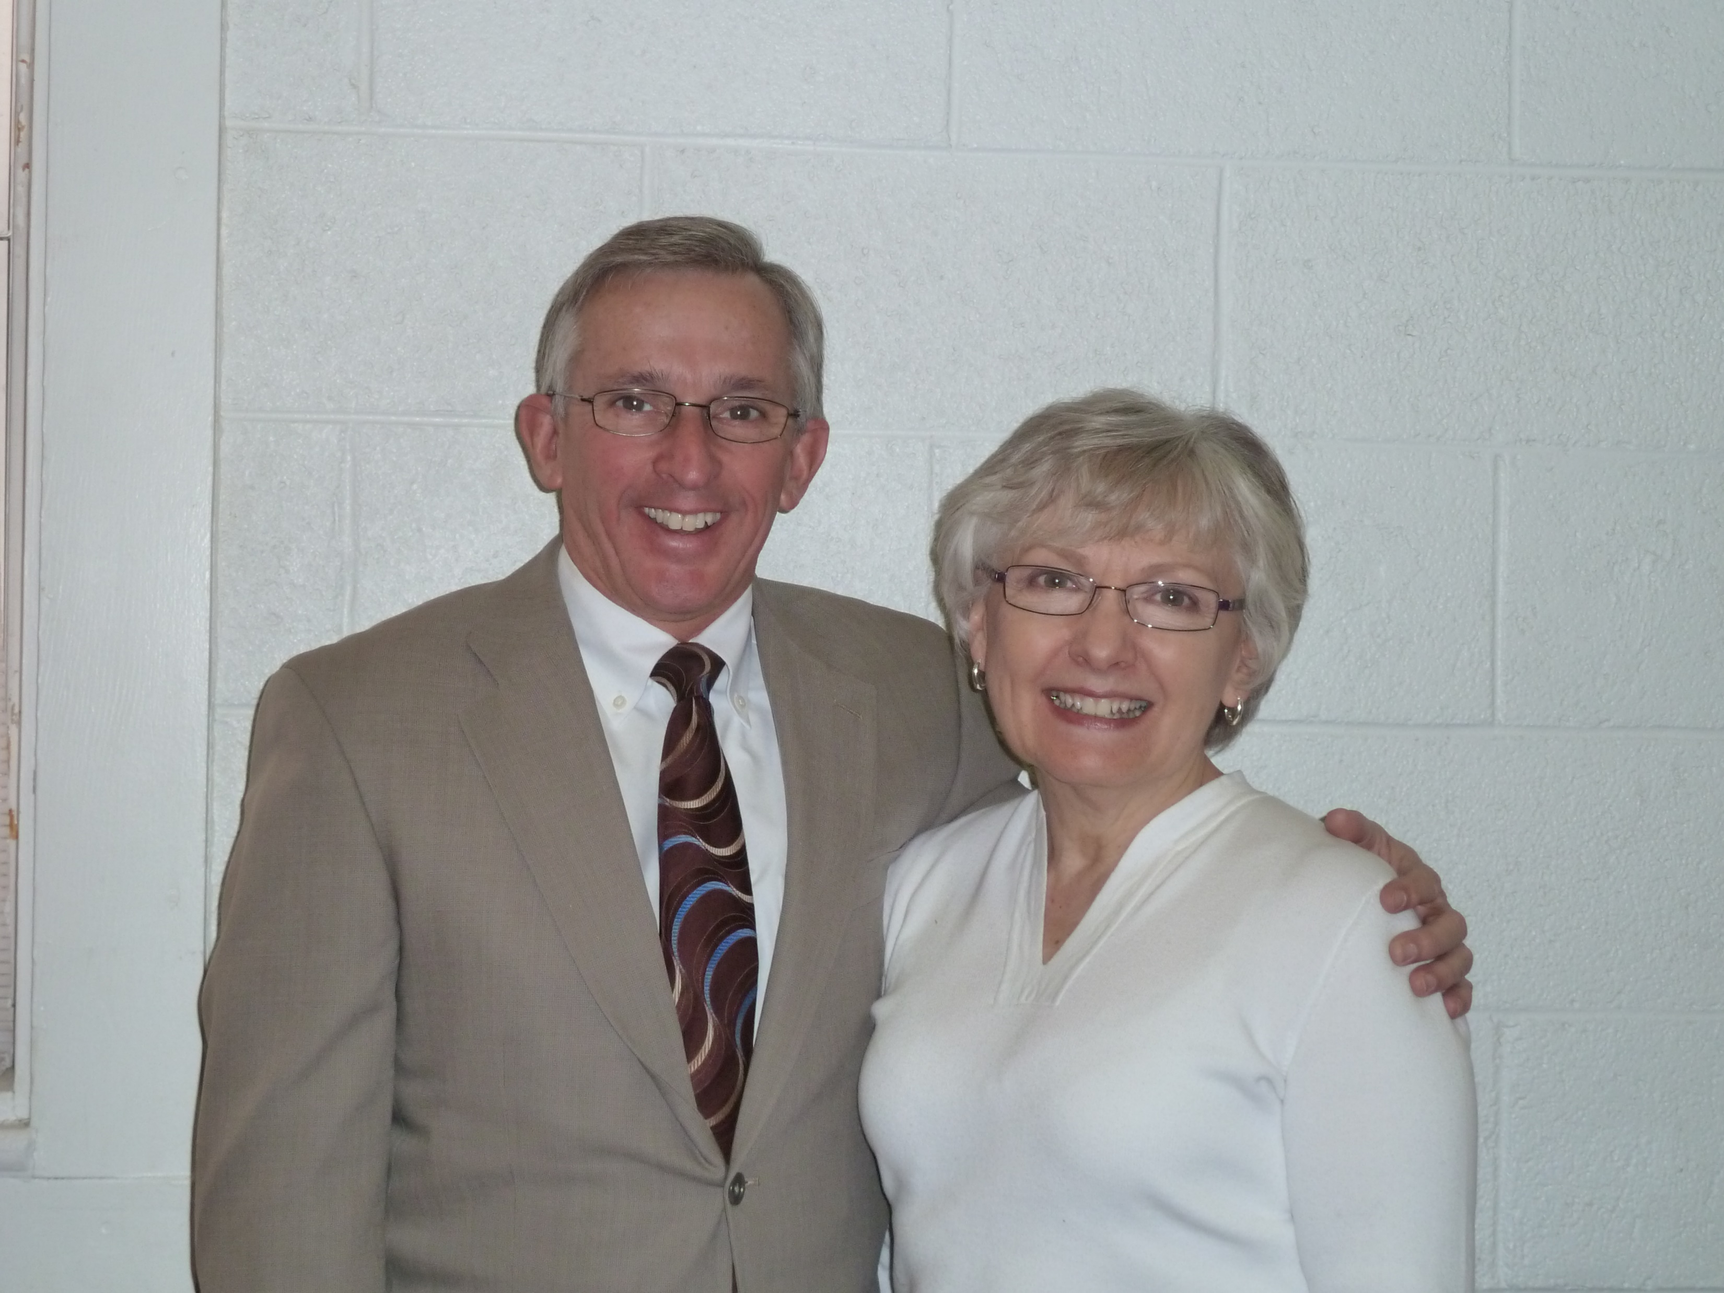
Pastor Randy and Becky Bray

Slide 44
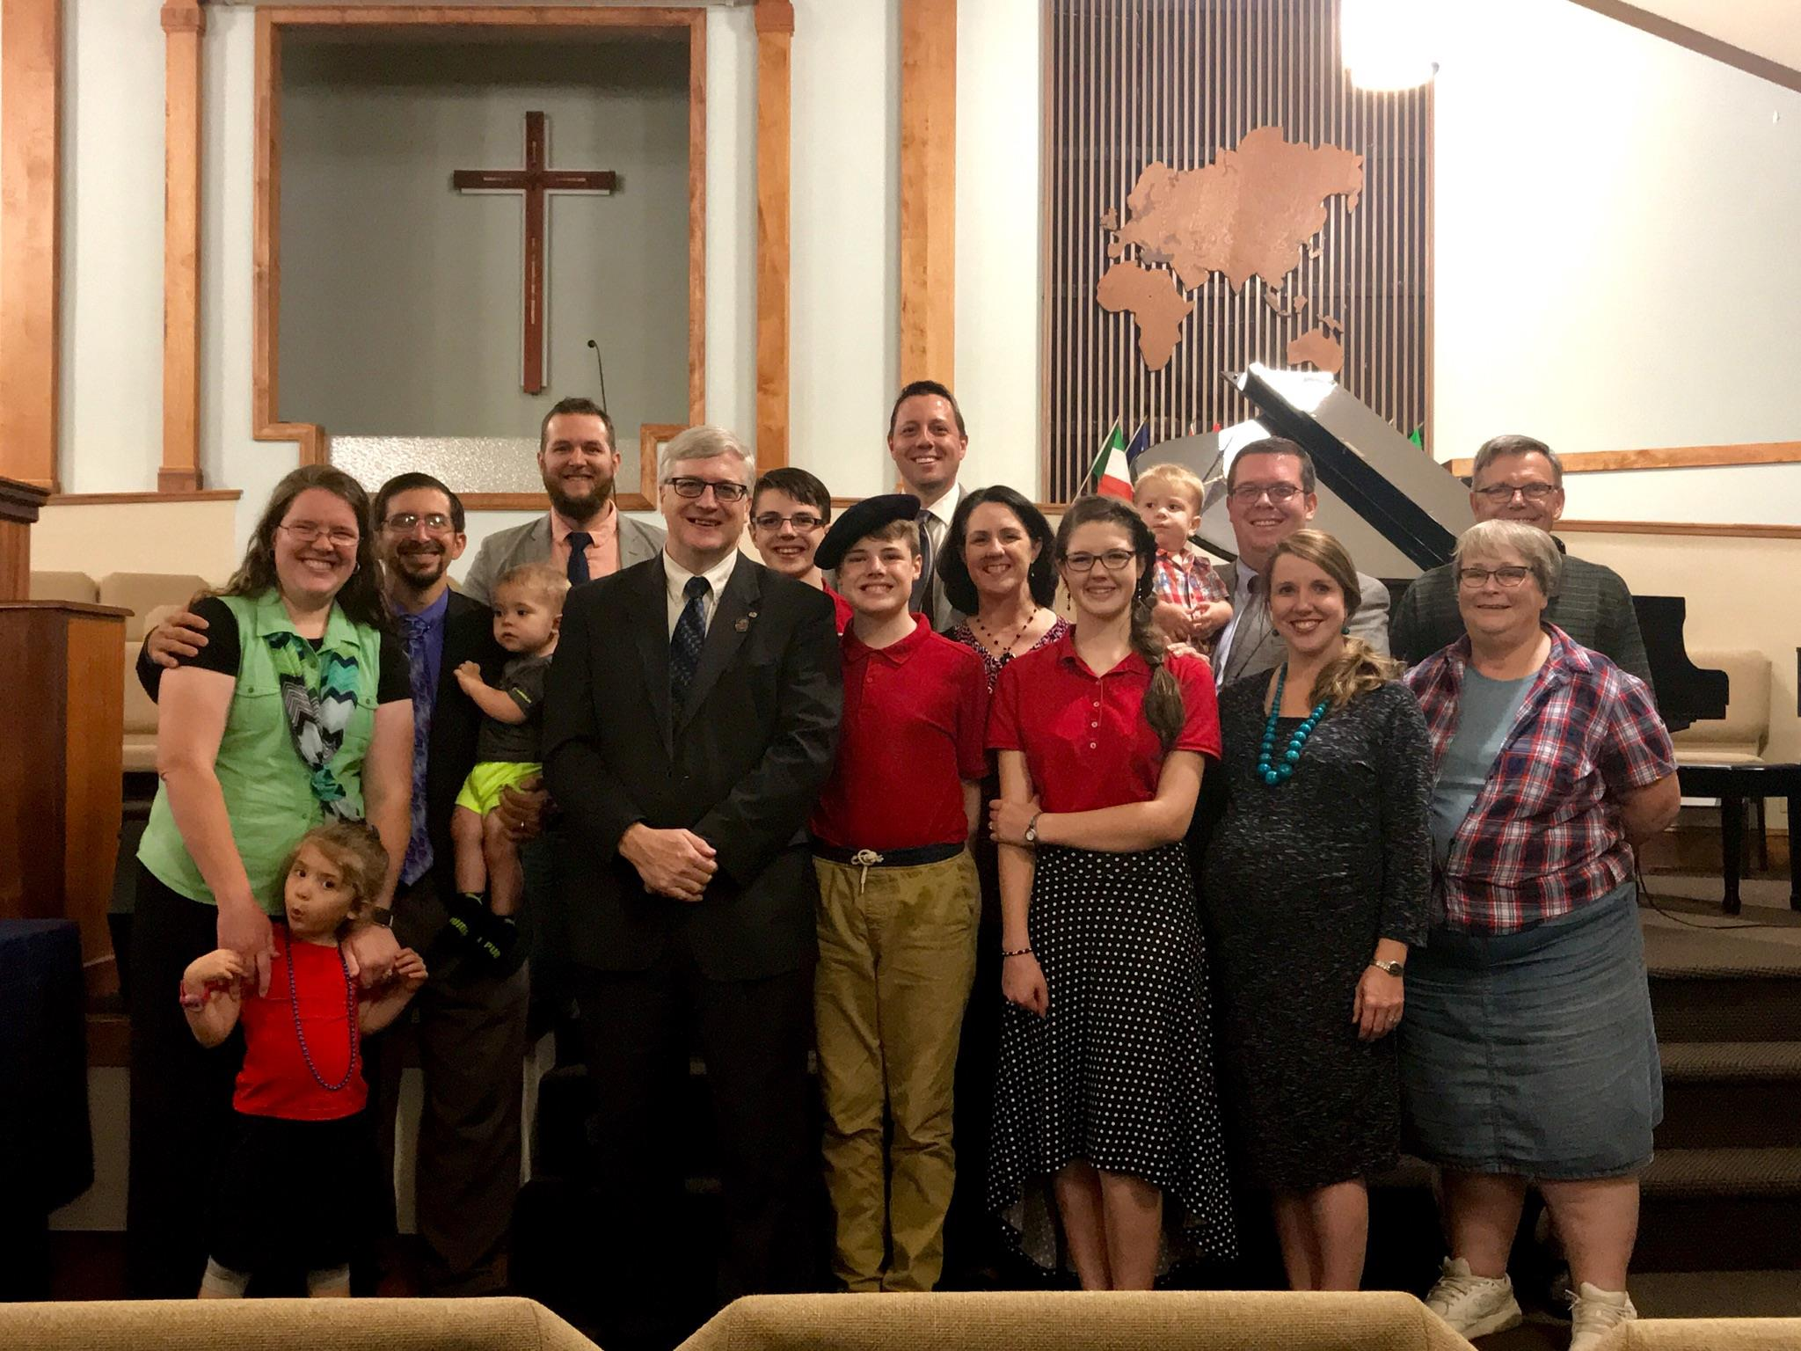
Missions Conference 2018

Slide 45
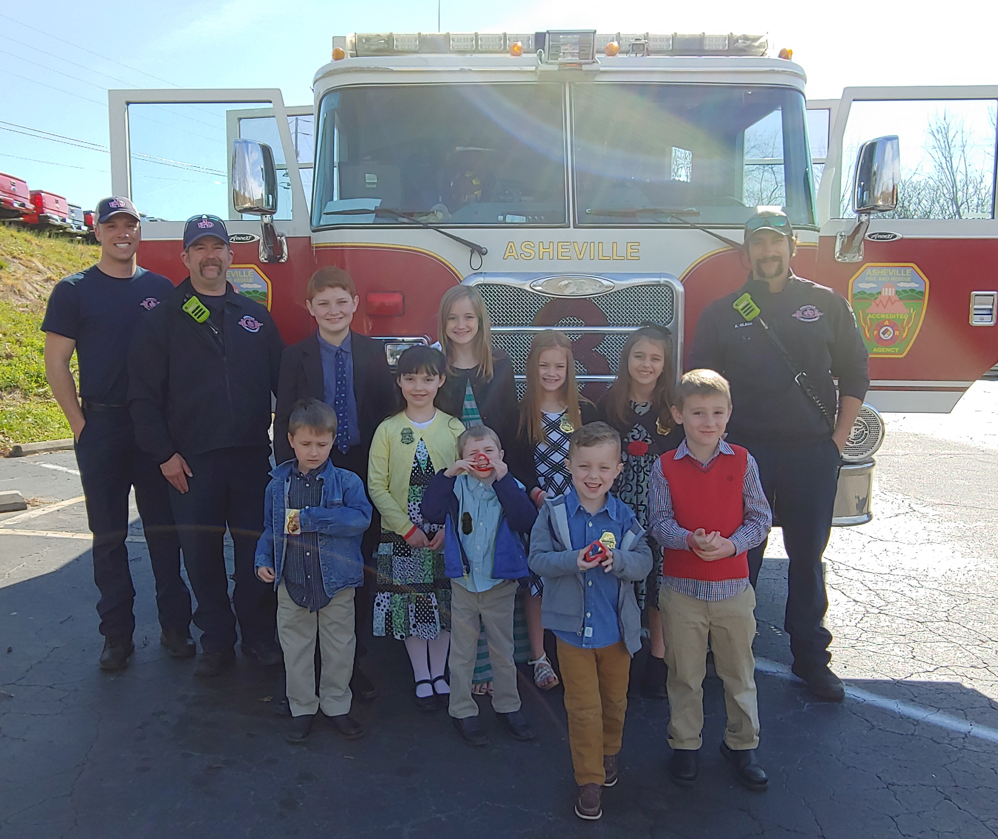
First Responders’ Sunday
2019

